Slide 1
Grammar Boot Camp!
Syntactic Forms & Functions for SLPs
Shelly Wier, MS, CCC-SLP
Consultant for School-Based SLP Services
Arkansas Special Education Resource Consultants
in association with the Arkansas Department of Education, Special Education Unit
Notes:
As many of you know, I go to the ASHA Schools Conference just about every summer. One of my goals each year, prior to attending, in addition to getting my hours for the year, ☺ is to identify a relevant topic on which to focus, and obtain resources that I can bring back to Arkansas to share in some way, usually as a workshop.
Last summer I attended an excellent session presented by Barbara Ehren (actually two sessions, but the one I’m starting with…) focused on “Teaching Language Knowledge, Skills, and Strategies to Older Students Who Struggle with the CCSS.”
“Older” meaning students in grades 4-12.
The other session was “Unpacking Discipline Specific Texts with Adolescents,” which she alludes to in the first session, using the term “disciplinary literacy.”
(You can look through that session’s handout during break, if you like, because I won’t be able to include much detail from it in today’s workshop, but it’s where I’m headed next time.)
My plan was to attend those two sessions and combine the information into a training on “Scaffolding” . . . but I got completely distracted by my own ignorance of grammar, hence today’s topic.
But before we put our boots on, as a warm-up for our brains, I want to take you through some information from the first part of Dr. Ehren’s session . . . to give you the big picture she addressed and help explain why I got sidetracked and why I think it’s important for us to review grammar before we work on scaffolding.
“Teaching Language Knowledge, Skills, and Strategies to Older Students Who Struggle with the CCSS.”

Slide 2
Important Differences
KNOWLEDGE: information the student recalls and understands
SKILLS: actions the student performs
STRATEGIES: tools the student uses to help him/herself recall, understand, & perform
Notes:
She was very specific about differentiating those three words: knowledge, skills, and strategies. And its importance in deciding and planning what to target.
Knowledge: information the student recalls and understands (receptive)
Skills: actions the student performs (expressive)
Strategies: tools the student uses to help him/herself recall, understand, and perform (metacognitive)
Just to clarify per Dr. Ehren . . . SLPs also use strategies to help themselves recall, understand, and perform, but SLPs use techniques to help others recall, understand, and perform.
Barbara Ehren is a great presenter, but her wealth of knowledge has always been intimidating to me in terms of being able to process it well enough to teach someone else. She provides very practical, usable information but it comes from a very deep well of sophisticated language knowledge and expertise.
I had pre-printed the handout and flipped through it ahead of time, thinking . . . “This should be good.”
She quickly reviewed the status of the CCSS in the country.
“Some states never signed on.” because they felt they already had high standards.
“Some states are abandoning CCSS, but not high standards.”
She predicted . . . (as we all could)
“More students will struggle to meet standards.”
“Students who struggle with language now will have [even] greater difficulty
mastering standards.”
She indicated that . . . [click]

Slide 3
Declarations are not enough!
Thou shalt learn at higher levels.
Thou shalt teach at higher levels.
Notes:
Declarations are not enough! Meaning . . .
Just because the stakes have been raised doesn’t mean students and teachers can immediately “up their game”.
High level thinking, which is what mastery in the CCSS, or any set of standards, is ultimately all about, goes beyond answering questions correctly. High level thinking is about quality not quantity. It’s thorough and complex. It’s metacognitive and metalinguistic. It requires internal and external use of “literate language.”

Slide 4
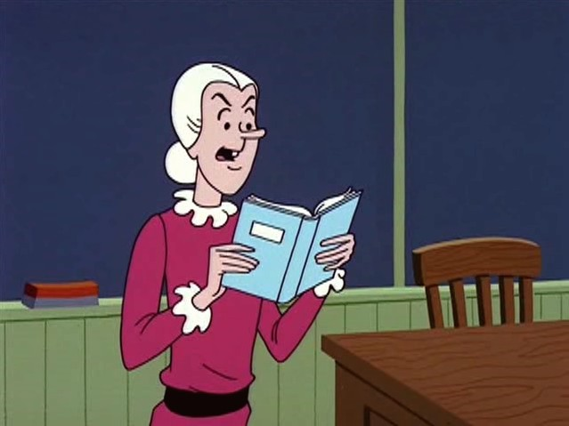
“I expect you all to be independent, innovative, critical thinkers who will do exactly as I say!”
Notes:
[Pause for cartoon.]
Does anyone who attended my Vocabulary workshop last year remember the components of “literate language?”
Conjunctions: coordinating, subordinating, correlating, etc.
Adverbs and adjectives
Linguistic verbs (DOK)
Metacognitive verbs
Embedded phrases
Elaborated noun phrases
I talked about this in reference to choosing target vocabulary (Tier 2) . . those high frequency words needed for more sophisticated, literate language. Literate language is also about grammar.
Still . . . what does that mean for us exactly? I always try to interpret in terms of “action.”
Then Dr. Ehren gave us a closer look at RIGOR.

Slide 5




Academic Rigor (Jackson & Lambert, 2010)
Applying Learning
Integrating^Skills
Organizing Information
Making Meaning
Notes:
Ehren shared Jackson & Lambert’s information on . . .
Academic rigor, which requires . . .
making meaning: knowing how to create their own meaning from what they learn
organizing information: so they create [retrievable] mental models
integrating individual skills: into whole sets of processes, and
applying learning: to new or novel situations, [tasks, and environments]
Thank you. That’s a little more concrete.
BTW… you can search eBay for Jackson & Lambert’s How to Support Struggling Students.

Slide 6
7 Myths About Rigor in Learning
Lots of homework is a sign of rigor.
Rigor means doing more.
Rigor is not for everyone.
Providing support means lessening rigor.
Resources equal rigor.
Standards alone take care of rigor.*
Rigor is just one more thing to do.*
(*www.Te@chThought.com)
Notes:
Dr. Ehren shared Blackburn’s (2014) 5 myths about rigor. I found 6-7 on TeachThought.com.
Then she starts talking about the “SLPs’ Contribution to Rigor” and it’s all about scaffolding, contingent responding; taking students from where they are to where they need to be.
I’m thinking . . . “Alright! Here we go! These are skills that SLPs have and use all the time. Techniques that are familiar, but probably could be better. This is why I chose this session. I can work with this. Bring it on, Barbara!”

Slide 7
Scaffolding involves . . .
SLPs working with students who need instructional intensity and our “language lens”
SLPs working with teachers who have to differentiate instruction
Notes:
She goes on with . . . [read slide]
I like that term “language lens” as it applies to how SLPs should view (or facilitate) the standards and curriculum, and how we should view (or facilitate) differentiated instruction and assessment.
I’ve also seen the term used recently in the title of UCA’s Spring Conference: Looking at Technology through a Language Lens.

Slide 8
Scaffolding requires . . .
“Knowing the Zone”
Not making targets/processes so difficult that it frustrates the student
Not making targets/processes so easy that the student gains nothing
Notes:
[Read first bullet]
If the student cannot produce correct responses even with scaffolding, it’s too difficult.
[Read second bullet]
If the student has no difficulty whatsoever and is doing everything correctly, it’s too easy.
I think this is easy to understand, but not always easy to recognize and act upon.

Slide 9
Ultimate Goal of Scaffolding
To build a repertoire of language
knowledge, skills, and strategies
that the student can access and use
on his or her own.
Therefore:
You must gradually remove scaffolds to prevent “learned helplessness” and to promote independence.
Notes:
[Read slide]

Slide 10

Language
Notes:
To effectively scaffold any learning, both in the therapy room and the classroom, SLPs have to look through our “language lens,” and be able to . . .
quickly identify the linguistic and metalinguistic steps between “too easy” and “too hard” for the task at hand AND
respond contingently, that is, recognize and provide the appropriate intermediate support “on the fly.”
Our “language lens” needs a phonology “setting,” and a morphology “setting,” and a syntax “setting,” and a semantic “setting,” and a pragmatic “setting.” Right?
You may think “Where does pragmatics fit into grammar?”
Capitalization and punctuation, which is, in my opinion, written prosody, and affects meaning much the same way.

Slide 11

Scaffolding Techniques include . . .
Questioning
Prompting and cueing student responses
Giving hints (semantic and/or phonemic)
Providing easier materials or practice examples and building to harder ones
Notes:
Whether you call it scaffolding or something else, these techniques are familiar to us.
[Discuss each technique.] [Participants’ examples.]
Questioning
Prompting and cueing
What would the sub bullets be?
Is there a sequence or cognitive hierarchy or a linguistic hierarchy to questioning?
Is there a sequence or hierarchy to prompting and cueing?
Does the scaffold (or support sequence) we provide depend on the target skill OR is there a general cognitive progression we should follow?
Think of those academic rigor requirements: making meaning, organizing info, integrating skills, and applying learning.
Scaffolding IS contingent responding, after all. But is it like a telemarketer’s script OR an “if-then” flowchart?? Or is every interaction unique to the student?
What metalinguistic skills (strategies) do SLPs need . . .
. . .to use these techniques effectively?
I swiped a slide from a previous workshop I did on Processing that has an example of Compensatory Cueing, which is not necessarily the same thing as Contingent Responding/Scaffolding, but gives you an idea of a sequence . . .

Slide 12
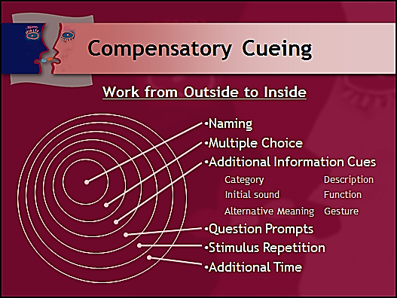
Notes:
This is an example for “NAMING.” You work from the outside circle in . . . to find the least supportive cue you can give THAT WORKS. The innermost circle is basically imitation.
[Demonstrate.]
Simple for NAMING. But what about other tasks?
So . . . should we create similar sequences for cueing the performance of other skills or is there a general progression that can be applied to many skills?
BTW
Language Processing Treatment Activities by Gail J. Richard and Mary Anne Hanner has a nice Recording Form (pp 24) that can assist in determining the most efficient types of cues for a student.

Slide 13

Scaffolding Techniques include . . .
Questioning
Prompting and cueing student responses
Giving hints (semantic and/or phonemic)
Providing easier materials or practice examples and building to harder ones
Notes:
Giving hints (additional info cues?). Is a phonemic hint more difficult, cognitively, than a semantic hint?
Remember: The questions, prompts and cues that we use shouldn’t be just a “means to a correct answer.”
In order to contribute to rigor, questions, prompts, and cues should stimulate and support the students’ “depth of knowledge.”
Remember that phrase and these colors. Think about what you know about Bloom’s Taxonomy (revised) and Webb’s Depth of Knowledge, which are coming up, and how they might apply to scaffolding or contributing to rigor.
Easier materials and practice examples. How do you develop these? Again, is there a sequence we should follow?
Where do Rubrics and Multi-dimensional scoring come into play?
Resources:
Handout: Asking the Right Questions
Language (Grammar), we know, as well as each of these techniques, I believe, has a hierarchy or structure that we must recognize, and use wisely, to stimulate and support the next higher level of thinking, and to help students build knowledge and develop skills and create strategies.

Slide 14
What SLPs Have to Know and Do
Know the components of the rigorous content and processes students are encountering in their classrooms.
  Standards: CCSS.ELA-LIT.WRITING.5.2
  Curriculum: write lab reports in science
  Instruction: teacher models template
  Assessment: work product and rubric
Notes:
So, Barbara . . . (See . . . now I think I’m on first name terms because I think I’m connecting with her material) . . .
Barbara begins to describe the things that SLPs have to know and do to be able to scaffold in a way that contributes to rigor. The first of five is . . .
Know the components . . . [read #1].
Apply our “language lens” to . . . [bullets]
Standard: CCSS.ELA-LITERACY.WRITING.5.2 Write informative/explanatory texts to examine a topic and convey ideas and information clearly.
W.5.2.A - Introduce a topic clearly, provide a general observation and focus, and group related information logically; include formatting (e.g., headings), illustrations, and multimedia when useful to aiding comprehension.
W.5.2.B - Develop the topic with facts, definitions, concrete details, quotations, or other information and examples related to the topic.
W.5.2.C - Link ideas within and across categories of information using words, phrases, and clauses (e.g., in contrast, especially).
W.5.2.D - Use precise language and domain-specific vocabulary to inform about or explain the topic.
W.5.2.E - Provide a concluding statement or section related to the information or explanation presented.
Curriculum: Write lab reports of experiments conducted in science. (or e.g. book report)
Instruction: Teacher models use of lab report template.
Assessment: Work product and a rubric on which the report is graded.
Immediately following her discussion of this example, Barbara said “Ask teachers for a scope and sequence or a syllabus or grading rubrics that will be used in the curriculum for instruction and assessment. I provide a Grammar Bootcamp for my students using Laura Justice’s syntax book and resources for second language learners.

Slide 15
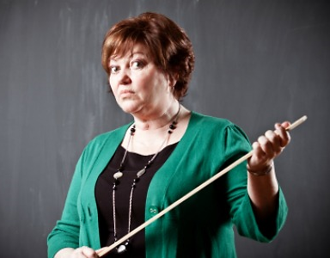
BONE
UP!!
GRAMMAR BOOTCAMP!
Notes:
BONE UP!!” she said, and I kinda felt like she stared us all down. [Glare]
Here is where my attention got side-tracked.
BONE UP!?! GRAMMAR BOOTCAMP!?! What did she mean? That particular writing standard certainly involves rigorous content and many language processes we could address. SCOPE AND SEQUENCE, GRADING RUBRICS I understand in reference to scaffolding, but why is she saying “bone up” on grammar?

Slide 16
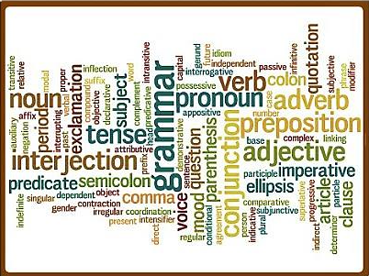
Notes:
So . . .
In the midst of this session, I reread this Writing standard with an eye specifically for grammar, thinking “Ok. This is similar to the Speaking and Listening standards, specially Standard 4 (report, sequence, describe clearly) or maybe Standard 6 (which refers to specific Language Standards).
How is the syntax necessary for writing so different from what we already work on . . . that she tells us to “bone up” on grammar?
And then (duh!!) it occurs to me . . . Writing requires knowledge and use of “literate language” more so than Speaking does, especially after age 10, which is grades 4+.
So I look up the ELA standards for 5th grade language, rather than 5th grade writing, and I begin to understand what she means by “bone up.”
Because when I looked at those 5th grade language standards, even going back through 4th and 3rd, then 2nd and 1st grades, I realized just how much I had forgotten about the specifics of grammar: relative pronouns, predicates, progressive verb tenses, dependent clauses, modal auxiliaries, subordinating conjunctions, irregular past tense, infinitives, determiners, demonstratives, gerunds and on and on.
All those very specific syntactic forms and functions that comprise “literate language.”
Now . . . I loved English is high school. Loved to diagram sentences. But I realized I had forgotten much more than I remembered. Sure, I can tell if your grammar is wrong, but I didn’t know the vocabulary anymore to describe it.

Slide 17
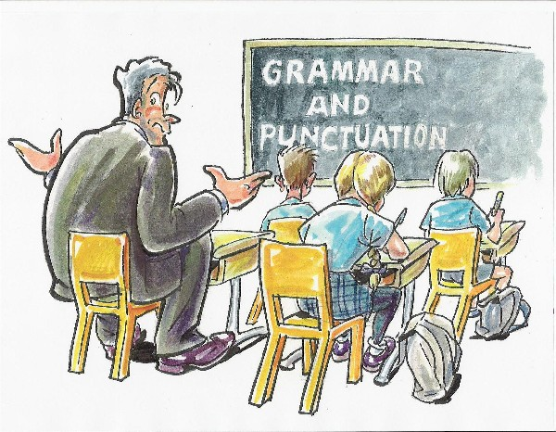
Notes:
I felt like this guy. And DR Ehren is saying “Bone up!” like it’s a prerequisite to everything else that’s coming. And the further into her session I got, the more I realized just how right she is.
[Notice I have respectfully returned to calling her DOCTOR Ehren.]
We’re the language experts. We should be able to analyze, explain, and discuss the sophisticated particulars of grammar development and use, and apply that to our assessment, scaffolding and goal-writing.
I didn’t think I could. . . and I wondered if YOU ALL could.
And this was only the first of 5 things SLPs have to know and do to scaffold in a way that contributes to rigor.
So I tucked the idea of a grammar bootcamp in my pocket and refocused my attention, which I will ask you to do for the moment, while I quickly finish giving you the remaining four things to complete the big picture.
As I do, though, be thinking specifically about how syntax applies.
The next thing SLPs have to know and do . . .

Slide 18
What SLPs Have to Know and Do
Know students’ achievement status
  Results of high stakes tests in content and literacy
  Results of classroom units tests
  Observations of difficulties by teachers
Notes:
. . . to be able to scaffold in a way that contributes to rigor?
Know students’ achievement status.
Apply our “language lens” to . . . [bullets]

Slide 19
What SLPs Have to Know and Do
Identify the language-related reasons students are struggling
  Linguistic
  Metalinguistic
  Cognitive
  Metacognitive
Focus on what is going on inside the kids’ heads!
Notes:
What do SLPs have to know and be able to do to scaffold in a way that contributes to rigor?
Identify the language-related reasons … [read slide].
[Discuss] Example: comparing and contrasting.
Linguistic: What linguistic knowledge and skills are needed?
Metalinguistic: What strategies are needed?
Cognitive: What cognitive knowledge and skills are needed? Same/different.
Metacognitive: What strategies are needed?
Does external language (spoken and written output) mirror internal language (needed for metaskills)?
What I mean is . . . Can we assume that whatever language we see and hear from students is the same language going on inside their heads . . . the same language they use to process . . . the same language used for making meaning, organizing info, integrating skills, and applying learning?

Slide 20
What SLPs Have to Know and Do
Differentiate what has to be taught
  Knowledge of language and the language features of different academic subjects (disciplinary literacy)
  Skills with which students are having difficulty (language & literacy)
  Strategies for acquiring and demonstrating knowledge . . . for listening, speaking, reading, and writing in the classroom
Communicate the difference to students.
Notes:
What do SLPs have to know and be able to do to scaffold in a way that contributes to rigor?
Differentiate what has to be taught.
Knowledge
SLPs should NOT be teaching academic subject content with the exception of “language”
SLPs SHOULD be teaching knowledge of the language features of different academic subjects (disciplinary literacy)
Skills
SLPs SHOULD be teaching language and literacy skills with which students are having difficulty
SLPs should NOT be teaching language or literacy “development” when it would typically be taught [Discuss]
Strategies
SLPs SHOULD be teaching students how to acquire and demonstrate knowledge
SLPs SHOULD be teaching listening, speaking, reading, and writing strategies to students who have language difficulties. Strategies for …
note taking from lecture and text
discussion in small groups and for oral presentations
comprehension before, during, and after reading
the various kinds of composition required in different subjects
Resources:
Handout: Comparison of Instruction and Therapy

Slide 21
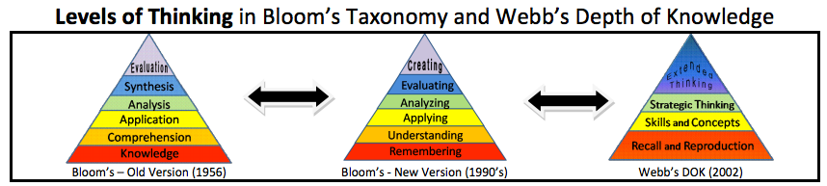
What SLPs Have to Know and Do
Differentiate levels of thinking required by questions and prompts.
Notes:
What do SLPs have to know and be able to do to scaffold in a way that contributes to rigor?
Differentiate levels of thinking required by the questions and prompts [we use].
Apply our “language lens” to . . . the thinking required for . . . [Reference chart in packet]
recall and reproduction [Red]
demonstrating skills/concepts [Yellow]
strategic thinking [Green]
extended thinking [Blue]
Our contribution to rigor involves scaffolding students’ knowledge, skills, and strategies to the top of the pyramid. High level thinking is blue!
[We need some metalinguistic strategies for asking questions and providing prompts.]
We have to look at more than single words (e.g. what, where, who, when, how, why) in determining the level of processing required by the questions we ask. Certainly, “how” and “why” are more advanced developmentally, but . . .
Focusing on a single “question” word does not reveal the question’s complexity. We must analyze the whole question or prompt to determine complexity: linguistic complexity and cognitive complexity.
What? question examples [Point to levels on slide]
What is the name of the major character in the story? [Red – recall and reproduction]
What is the difference in the behavior of the two men? [Yellow – skills and concepts]
What would you ask the author about his reason for writing the story? [Green – strategic]
How? question examples [Point to levels on slide]
How would you describe Abraham Lincoln? [Red]
How would you compare Lincoln and Davis? [Yellow]
How does the War Between the States fit within the context of economic growth in the U.S.? [Green]
How might the WBS have ended differently if the South had more financial resources and soldiers? [Blue]

Slide 22

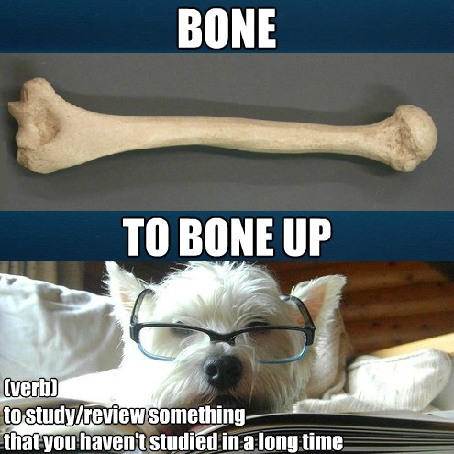
Notes:
In a way, differentiating the level of thinking, brings us back around to understanding grammar and literate language.
Again, I ask . . .
Does external language (spoken and written output) mirror internal language (used for metaskills)?
What I mean is . . . Can we assume that whatever language we see and hear from students is the same language going on inside their heads . . . the same language they use to process . . . the same language used for making meaning, organizing info, integrating skills, and applying learning?
I now agree with Dr. Ehren, in that we need to BONE UP!
Anyone providing educational services to students with language disorders needs sophisticated knowledge of syntax. Although many students’ language disorders encompass the range of linguistic domains (semantics, pragmatics, phonology), language disorders nearly always involve or affect the syntactic or grammatical system.
Or in other words . . . we need to upgrade the syntax and morphology “settings” on our “language lens” before we can stimulate and support the growth of literate language.
To do that we’ve got to be able to distinguish Form from Function and apply it in many ways.
So . . . let’s get started.

Slide 23
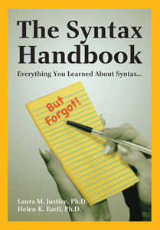
Everything You Learned About Syntax . . . But Forgot!
by
Laura M. Justice, Ph.D.
and
Helen K. Ezell, Ph.D.
(2008)
Notes:
This is the book on which I have based today’s Grammar Bootcamp.
The authors, both university professors, found that many of their students (grad and undergrad) struggled with syntactic terminology and analysis in classroom and clinical tasks. Specifically, with analyzing the syntactic structures present (or absent) in clients’ language, or with analyzing clause or sentence structure in the narratives of school-age children, and with designing educational goals related to syntax.
The students felt that their lack of a solid understanding of syntax was hindering their ability to participate in higher-level analysis activities. So they asked for materials to help them better understand syntactic forms and functions and their relationship to syntactic analysis.
When these professors started looking for materials and asking working professionals for suggestions, they were unable to find what they needed. In the process, the working professionals also made similar requests for materials.
So the authors wrote this handy reference tool to fill the void in our profession and help ease the frustration of learning about syntax even after you’ve mastered the basics. They describe it as “educationally relevant, friendly, and fun, as fun as syntax can be.”
I bought the eVersion first through Pro-Ed so I could start reading while I was laid up with a broken ankle over Christmas. I had to order the hard copy from B&N. Make sure you get the 2008 edition.
It provides a reader-friendly review of the syntactic terms most frequently encountered and used by language interventionists. Eight chapters are devoted to form and four to function, plus developmental data and practice application exercises.
The book also contains a great glossary and a number of helpful appendices for quick reference. And since these are the only parts of my eVersion I’m allowed to print besides the Intro and Table of Contents, I did. And provided copies for all of you, in case you don’t buy the book. They will also come in handy today, me thinks.

Slide 24
Two Levels of Analysis
Syntactic Form
refers to the grammatical category
generally independent of the word’s role
AKA “parts of speech” (noun, verb, adverb)
Syntactic Function
refers to the role of a word or group of words in relation to the rest of the elements in a phrase, clause, or sentence
AKA “parts of sentences” (subject, object)
Notes:
Broadly speaking, syntax refers to “the architecture of phrases, clauses, and sentences” in a language. In other words, syntax is the combination of words into sentences on the basis of rules inherent to a language. We know this.
A consideration of syntax must take into account two distinct levels of analysis: syntactic form and syntactic function.
[Read slide]
Take the word apple, for example. The word apple almost always takes the same syntactic form (noun) across different sentences, but its function can differ based on its role in the sentence.
In the sentence . . . The apple is rotten, apple functions as the subject of the sentence.
In the sentence . . . I picked the apple, apple functions as the object of the sentence.
A discussion of syntactic form uses terms like noun, pronoun, verb, adjective, and adverb.
A discussion of syntactic function uses terms like subject, object, predicate, clause, and phrase.
Everybody say . . . “That’s right! I knew that.”

Slide 25
Opdycke (1965)
“The sentence is the unit of speech, that is, of expression. The isolated word or part of speech is, in the main, a detached tool only, to be kept handy and ready for use in association or relation with other words or parts of speech . . .
The word - the part of speech - in and of itself is indeed nothing but a cold combination of letters.
It usually needs the society of other words – other parts of speech – to give it vital spark.”
Notes:
I like this quote from the book.
The sentence is the unit of expression . . . words are detached tools . . . a cold combination of letters . . . a word needs the society of other words to give it vital spark.

Slide 26
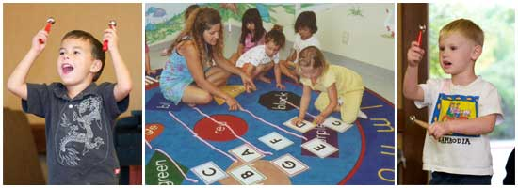
Example: 4-year-old w/SLI
“me go” I am going.
“give me cat” Give me the cat.
“that girl” That is a girl.
    nominative pronouns (using me for I)
    auxiliary verbs (omitting am)
    verb tense inflections (go for going)
    articles (omitting the and a)
    copular be (omitting is)
Notes:
Basic syntactic analysis should be a commonplace activity for SLPs and is an important tool for preventing, identifying, and remediating language disorders. We must have familiarity with key syntactic structures to be effective when assessing students, when formulating goals/objectives, monitoring progress, and when evaluating outcomes.
Let’s look at an example. Here are three utterances from a 4-year-old with Specific LI.
[Read slide]
We are familiar with this “telegraphic quality” of speech when it’s developing and/or when key structures are missing. But can we describe the errors and what they mean?
I want you to take a few moments to jot down the problems you see and what syntactic difficulties they indicate? I’ll give you the first one:
[click]
Using me for I …indicates difficulty with nominative pronouns.
[Wait to click in answers.]
omitting am …indicates difficulty with auxiliary verbs
using go for going …indicates difficulty with verb tense inflections
omitting the and a …indicates difficulty with articles
omitting is …indicates difficulty with copular be
At a glance, like I just asked you to do, I think I could have listed those (errors), but I don’t think I could have finished the sentence “indicates difficulty with . . .”, although it made sense when I read it . . .
. . .nor could I say exactly when those particular forms and functions should be present developmentally, although I do know it’s earlier than 4 years of age.
I can almost recall Brown’s stages and MLU because it generally follows age in months. . . but past that I have problems recalling the items in Brown’s chart, much less understanding them well enough to scaffold instruction. Glad to have the handy reference, but still . . . my vocabulary for this kind of analysis is weeeeeak!!!
This is just a 4-year-old learning how to talk, not a 4th grader, who is dealing with both spoken and written language in the CCSS. This example is in the Introduction of the book and I thought “Oh boy!”.

Slide 27
Example Syntax Objectives
The student will use the present tense copular forms of be in 90% of obligatory contexts given an eliciting prompt.
The student will produce a third person regular present tense verb in 9 of 10 trials given models.
The student will use articles and conjunctions during conversational speech with 85% accuracy.
The student will use compound and complex sentences in spontaneous speech during classroom activities with 90% accuracy.
Notes:
Here are some examples of “typical” syntax objectives (not related to those 4yo utterances), also in the Introduction.
[Read slide]
Quick!
Someone give me a “third person regular present tense verb” . . . he/she/it _____
--- talks, plays, gives, makes (add “s” to verb)
Irregular present tense adds “es” or “ies” to the verb: fixes, carries.
So . . . morphology, right?
What are the “present tense copular forms of be” . . . I/you/it _______
-- am, are, is
A long-term goal might emphasize the “use of age-appropriate syntactic structures.”
Do any of you write syntax objectives like these?
Regardless of whether we are addressing listening, speaking, reading, or writing, as SLPS we must be prepared to specifically define and illustrate these syntactic terms, not only for assessment and when writing goals/objectives, but also for designing interventions, discussing with others, and for monitoring outcomes.

Slide 28

What Is a Noun?
Persons, Places, Things or . . .
. . . Abstractions
Labels we use to classify the world and our experiences in it
Simple or Compound
Noun Classes
Noun Forms
Notes:
We all learned in elementary school that nouns are persons, places, or things. But this definition, while certainly accurate, needs to be broadened to include words like July, liberty, language, sadness, and solitude, which don’t really fit into those categories.
Is July a thing? Kessler and McDonald (1991) added “Abstractions” to the definition. Given that time is abstract, July better fits this category since it classifies a particular period of time.
Regardless of how you define “noun,” it is agreed that nouns can be
simple or compound, and can be sorted into
noun classes and
noun forms.

Slide 29
Simple and Compound Nouns
Simple nouns: consist of a single word, e.g. man, store, key, hope
Compound nouns: consist of more than one word and can occur in several forms
  Closed: two words combine to form a single word, e.g. swimsuit, wristwatch
  Open: two separate words used together, e.g. vice president, high school
  Hyphenated: e.g. brother-in-law, ex-wife
Notes:
[Read slide]
So Simple or Compound is about the number of words making up the noun. This is going to apply to almost every other part of speech as well.

Slide 30
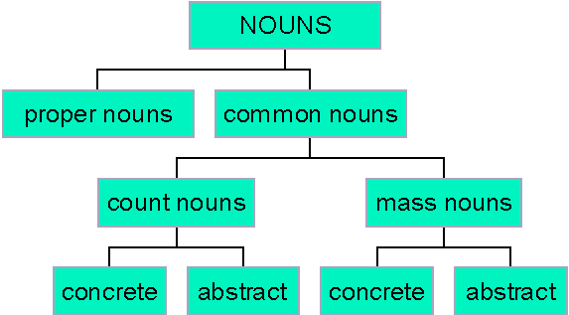
Noun Classes
Common and Proper
Count and Noncount
Concrete and Abstract
Collective Nouns
Notes:
Nouns may be characterized into different classes as well, given the types of things (or persons, places, or abstractions) to which they refer.
These include common and proper nouns, count and noncount (AKA mass) nouns, concrete and abstract nouns, and collective nouns (which is not on the diagram).

Slide 31
Common and Proper Nouns
cat
stability
linen
box
friend
street
beauty
Homer
Chevrolet
McDonald’s
Mrs. Smith
Arkansas
Oak View Drive
Black Beauty
Notes:
These are the easy ones.
Common nouns refer to a general group or class of indefinites:
animal,
condition,
material,
object,
person,
place, or
quality.
Examples, respectively, might be cat, stability, linen, box, friend, street, or beauty.
Let’s not confuse “common” with “concrete.” Stability and beauty are common nouns, but not concrete nouns. In writing, common nouns are typically not capitalized.
Proper nouns refer to specific entities, such as Homer, Chevrolet, McDonald’s, Mrs. Smith, Arkansas, or Black Beauty, and are nearly always capitalized.

Slide 32
Count and Noncount Nouns
desk
leg
clock
bowl
banana
pencil
progress
mail
wheat
courage
cement
mathematics
Notes:
Nouns that represent countable objects are Count Nouns. They refer to entities that are viewed as individual elements or units, such as letter, pizza, and minute. You can count them.
On the other hand, Noncount (or Mass) Nouns refer to entities that are not usually viewed as having individual elements; they have no specific shape or boundary, or they simply cannot be counted, like corn, honesty, and fortitude. You cannot, for example, have one or more “honesties.”
A helpful tip for remembering these is that count nouns in their plural form may be modified by the word many, and noncount nouns may be modified by the word much. Try it on these examples.
desk – many desks, not much desks
progress – much progress, not many progresses
It does get tricky though. Some nouns can be count or noncount depending on context (or syntactic function).
For example, stone is a count noun in Each stone was polished, and it is a noncount noun in My house is made of stone.
Proper nouns are even more confusing since it can be argued that a proper noun is the name of a unique entity. And if it is truly unique, there cannot be more than one, making it neither a count noun or a noncount noun, but a unique noun.
Red Lobster?

Slide 33
Concrete and Abstract Nouns
camera
curtain
iMac
Eiffel Tower
sandwich
cereal
fear
love
idealism
reason
youth
logic
Notes:
Nouns may also be divided into Concrete and Abstract Nouns. Concrete nouns refer to tangible, physical entities, whereas Abstract nouns refer to intangible, nonphysical entities (that is, entities we cannot discern with the five senses).
Abstract nouns are often words that we use when describing our . . .
ideas,
emotions,
senses, and
situations.

Slide 34
Collective Nouns
jury
neighborhood
staff
committee
luggage
family
group
audience
Rolling Stones
flock
choir
china
Notes:
Collective Nouns are those that can name a group acting as a unit. These nouns may be either singular or plural in meaning, as context dictates.
For example, the noun staff can be used in a sentence like The staff is going to the conference when meaning the staff members as a unit . . .
. . . or it can be used with a plural verb in a sentence like The staff have all had the flu to place emphasis on the individual members of the staff.
Collective nouns can be plural in form (e.g. juries, groups), but some are always singular in form (e.g. luggage, china).

Slide 35

Noun Forms
Number – Is it singular or plural?
Gender – Is it masculine, feminine, indefinite, or neuter neutral?
Case – Is it nominative, possessive, or objective?
Notes:
Each noun can generally be characterized by three dimensions of form:
Number (Is it singular or plural?)
Gender (is it masculine or feminine, indefinite, or neuter?) I didn’t like the idea of possibly having to use that word with teachers or parents, so I chose to change it to “neutral” which I think serves the same purpose. You with me?
Case (Is it nominative [subjective], possessive, or objective? What part of the sentence? Role or function?)

Slide 36
Noun Form - Number
pan
bench
mouse
syllabus
foot
datum
pans
benches
mice
syllabi
feet
data
Notes:
Many nouns can change form to denote the number of entities to which they are referring. A noun that denotes one entity is singular; a noun denoting two or more entities is plural.
Often, the plural of a noun is created by adding –s or –es to the singular form, such as pan → pans and bench → benches.
However, we know that irregular nouns have a unique plural form that does not follow this rule. Some examples include . . . [read slide]
Some nouns do not have a plural form at all, e.g. deer, moose, more often proper nouns. Only one Mississippi River; only one Barbara Ehren.

Slide 37
Noun Form - Gender
Masculine: man, bishop, stallion, prince, gentleman, rooster
Feminine: woman, nun, hen, empress, lady, ewe
Indefinite: child, doctor, sibling, parent
Neutral: molecule, chair, screen, arrow
Notes:
Many nouns can be characterized in terms of gender.
Masculine nouns apply to males.
Feminine nouns apply to females.
Indefinite nouns apply to both or either gender.
Neutral nouns carry no gender connotation at all.
Pretty simple, but not really something we really address with nouns – pronouns, yes.

Slide 38
Noun Form – Case (Role)
Nominative (AKA Subjective), Objective, or Possessive, depending on its role in the clause or sentence
No change in form from nominative to objective case (e.g. Jenny, note)
Most nouns are not case sensitive unless they are serving in the possessive case
Possessive case is usually marked by ‘s and denotes ownership
Notes:
Noun forms can also be characterized as nominative case (AKA subjective), objective, or possessive case, depending on its role in a clause or sentence.
The nominative case is used when nouns are serving/functioning as the subject in a sentence; the objective case is used when nouns are serving as the object in a sentence. Although no longer true in English, nouns in many other languages change in form from the nominative to the objective case.
In Jenny wrote the note, the proper noun Jenny is in the nominative case and the common noun note is in the objective case. In English, the forms of these two nouns do not change even if their roles in the sentence are reversed to form The note was written by Jenny. (note did not become “notum”, for example, when its role changed).
Most nouns are not case sensitive, unless they are functioning in the possessive case, which is usually marked by the possessive ‘s and denotes ownership.
Pronouns are case sensitive for all three cases. That’s coming up.

Slide 39
Developmental Notes: Nouns
You have a handout containing developmental notes for each grammatical form we address.
Please review the appropriate section as needed during the following Application Exercises.
Notes:
[Leave this slide up while preparing Application Exercises.]

Slide 40

Application Exercises
1A: Noun Description
1B: Proportion of Nouns
Notes:
[Review activity directions. Allow time for completion. Provide and discuss answers.]

Slide 43
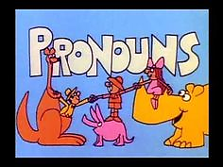
What Is a Pronoun?
A finite, closed-class group of words that can take the place of nouns
Play an important role: Efficiency
Key requirement: Direct or indirect identification of the antecedent/referent
Personal
Demonstrative
Indefinite
Relative
Interrogative
Notes:
Anyone remember Rufus, Xavier, and Sarsaparilla? [Read first bullet]
Finite, Closed-class . . . meaning there is a relatively unchanging number of pronouns. Unlike nouns, since new ones are constantly being created (e.g. cyberspace, Harry Potter), and others are fading away from disuse (e.g. typewriter, cassette).
[Read second bullet] Pronouns allow us to be more efficient in our communication. They remove the reduplication or repetitiveness that would occur if we constantly had to rename a noun each time we referenced it.
Consider this sentence:
I grabbed the shiny, green apple Susan wanted, and then I threw it to her.
Without pronouns, this sentence would be:
Shelly grabbed the shiny, green apple Susan wanted, and then Shelly threw the shiny, green apple to Susan.
This example also illustrates the important, key requirement of ensuring that you make clear which nouns particular pronouns are referring to. When this reference isn’t clear, sentences become ambiguous.
Therefore, a key requirement for using most pronouns is that the antecedent (AKA referent) for the pronoun is identified, either directly or indirectly and so becomes shared (or known) information between the communication partners.
In this sentence, the antecedent/referent for it is apple and the antecedent for her is Susan. The antecedent for I is more subtle since it represents the speaker of the sentence.
The finite group of pronouns in English may be categorized into various classes:
personal
demonstrative
indefinite
relative
interrogative

Slide 44
Personal Pronouns
NUMBER | CASE
Singular | Nominative | Objective | Possessive
First Person | I | me | my/mine
Second Person | you | you | your/yours
Third Person (Masculine) | he | him | his
Third Person (Feminine) | she | her | her/hers
Third Person (Neutral) | it | it | its
Plural | Nominative | Objective | Possessive
First Person | we | us | our/ours
Second Person | you | you | your/yours
Third Person | they | them | their/theirs
Notes:
Personal pronouns replace nouns that represent persons or entities. Like nouns, pronouns can be categorized by number, gender, and case. Unlike nouns, case IS important and the same three apply: nominative (subjective), objective, and possessive.
The characterization of pronouns into either nominative or objective case depends primarily on the entity to which the pronoun is referring. That is, you must ask yourself if the pronoun is referring to the person or thing doing the action (nominative) or the person or thing receiving the action (objective).
The possessive case, again, is used to signify ownership. When possessive pronouns are used to clarify information about a noun that immediately follows it (our parents, his book), they are also called determiners, which will be presented later.
The form of the pronoun changes as a function of whether the pronoun encompasses the speaker (first person) or other people (second/third person), and also as a function of the number of entities being encompassed by the pronoun (I versus we).
Some pronouns also differ in form as a function of gender. Specifically, the third person singular pronouns vary depending on the gender of the entities to which they refer. The first and second person singular pronouns do not change form this way.
Reflexive pronouns are a special type of personal pronoun used when a person or entity performs an action on his-, her-, or itself (or –selves). They are sometimes called compound personal pronouns.

Slide 45
Demonstrative Pronouns
Pronouns or adjectives that identify or highlight a particular antecedent
AKA “grammatical pointers”
Deictic: meaning shifts with location of speaker
 | SINGULAR | PLURAL
Near Speaker | this | these
Away from Speaker | that | those
Notes:
Demonstratives can function as pronouns or as adjectives that identify or highlight a particular antecedent. In other words, they DEMONSTRATE.
They are also referred to as “grammatical pointers.”
Demonstrative pronouns are this and that and their plural forms these and those. This and these refer to entities that are near the speaker. That and those refer to entities that are away from the speaker.
These pronouns are called deictic because their meaning shifts with respect to the location of the speaker.
The antecedent for demonstrative pronouns may be in the same sentence as the pronoun, may be in the previous sentence, or may be unstated due to context.
Mark this slide for later . . . when we talk about Demonstrative Adjectives. The same words apply.

Slide 46
Indefinite Pronouns
all
any
anybody
anyone
anything
both
each
either
every
everyone
everything
many
much
nobody
nothing
one
other
several
some
something
such
Notes:
Indefinites can function as pronouns or as adjectives, and have general, unstated referents - whereas other types of pronouns have specific antecedents – even if the reference is established only through context.
An example is the indefinite pronoun nobody, which does not refer to a specific person or group of people, but rather a general (and nonexistent) group.
There are many indefinite pronouns in English. These are some common ones.
[Refer to slide]
Some carry an implicit plurality to them, such as everyone and several, and others are intrinsically singular, such as one and each.
Mark this slide for later . . . when we talk about Indefinite Adjectives. The same words apply.

Slide 47
Relative Pronouns
Two roles:
  Refer to a noun or pronoun (as usual) &
  Embed or conjoin a portion of a sentence to the rest of the sentence via subordination
Relative Clause: a component of a complex sentence that includes its own subject and its own predicate (verb structure), but cannot exist alone, outside of the sentence
who, whoever, whom, whomever, whose, what, whatever, which, whichever, that
Notes:
Relative pronouns have two roles:
They refer to a noun or a pronoun, as do the other pronoun types, and
They embed or conjoin a portion of a sentence to the rest of the sentence via subordination.
We have not yet discussed relative (or dependent, or subordinate) clause structure, so here is a quick reminder.
[slide] A relative clause is a component of a complex sentence that includes its own subject and its own predicate (or verb structure), but cannot exist by itself outside of the sentence; it must be linked to an independent clause.
Some common relative pronouns are who, whoever, whom, whomever, whose, what, whatever, which, whichever, and that.
In the sentence Lynn told her who was coming, the relative clause is who was coming. It cannot logically stand alone; it must be joined to an independent clause, like Lynn told her.
The relative pronoun who has the role of making this connection happen (cohesive link).

Slide 48
Dual Role of the Relative Pronoun
We have Mrs. Riley for class.
Mrs. Riley is supposed to be very demanding.
becomes
We have Mrs. Riley, who is supposed to be very demanding, for class.
Who takes the place of the noun (primary)
Who joins the second sentence to the first (secondary)
Notes:
This example shows the dual role of the relative pronoun. [Read slide]
You might think that relative pronouns would be easy to identify when analyzing syntactic form, however, they are often omitted and simply assumed. Consider the sentence: The money I used to pay her was not mine. What is the relative pronoun that was omitted/assumed? [that]
This can sometimes make identification of the relative pronoun – and the relative clause it introduces – elusive.

Slide 49

Interrogative Pronouns
Pronouns or adjectives used to ask Wh- questions
Examples include who, whose, whom, what, and which
AKA question words
Notes:
[Read slide]
Mark this slide for later . . . when we talk about Interrogative Adjectives. The same words apply.

Slide 50
Developmental Notes: Pronouns
You have a handout containing developmental notes for each grammatical form we address.
Please review the appropriate section as needed during the following Application Exercises.
Notes:
[Leave this slide up while preparing Application Exercises.]

Slide 51
Application Exercises
2A: Pronoun Description
2B: Error Identification
Notes:
[Review activity directions. Allow time for completion. Provide and discuss answers.]

Slide 54

What Is a Verb?
Signify an action or state of being
Describe what nouns and pronouns do
Describe what is done to nouns and pronouns
Allow us to request, prompt, command, and cue
  Verb Classes
  Verb Forms
  Verbals
Notes:
Verbs, as we learned in elementary school, are the action words of sentences; an important class of words that signify action or state of being . . . words that “mirror existence and action.” Dynamic words that form the “muscle of a language” (Turner, 1966). That said, what are they . . . really?
Verbs are those words that describe what nouns and pronouns do . . . and what is done to nouns and pronouns.
Verbs are what allow us to request, prompt, command, and cue. Think of the way you talk to your dog. “Come! Sit! Stay! Fetch!” These four sentences consist solely of verbs, and demonstrate that a verb is strong enough to serve as a sentence all by itself – again, the muscles of our language.
However, this doesn’t explain the verb “is” in the sentences . . . Deacon is my dog. Deacon is black and white.
In these sentences, is doesn’t really describe what a noun is doing or what is being done to a noun. Is doesn’t signify an action.
But, remember, verbs can also signify a state of being (or mirror existence). This part of the definition explains the role of is in these two sentences, that of “connector” between Deacon and his “state of being” . . . my dog and his state of being black and white.

Slide 55
Verb Classes: Main & Auxiliary
Main verbs:
Principle descriptor of an action
or state of being
Can stand alone
Auxiliary (AKA Helping) verbs:
Conjoined with main verbs to clarify the action or state of being depicted
Cannot stand alone
Notes:
Verbs can be divided into two major categories: main verbs and auxiliary verbs. Main verbs serve as the principle descriptor of an action or state of being. They include words like eat, walk, and stand up (also a “prepositional verb” which we’ll talk about later).
Auxiliary verbs, sometimes called helping verbs, are conjoined with main verbs to clarify the action or state of being that is depicted by the main verb. They provide additional information about person, tense, mood, and so forth.
Consider the following examples and how they clarify what Casey is doing.
Casey will talk. Casey may talk. Casey can talk. Casey should talk.
The meaning of each sentence is subtly different from the others, and these shifts in meaning are signaled by the auxiliaries. Casey and talk remain the same across all sentences.

Slide 56
Common Auxiliary Verbs
be^{b}
had
am^{b}
shall^{m}
need^{m}
can^{m}
was^{b}
may^{m}
have
will^{m}
must^{m}
get
are^{b}
ought^{m}
has
been^{b}
^{m} core modals
do
should^{m}
is^{b}
could^{m}
were^{b}
might^{m}
did
would^{m}
^{b} Be verbs
Notes:
In English, be, have and do are three commonly used auxiliary verbs. They are often used to denote person and tense for main verbs. They are not the only auxiliary verbs, though, as you can see from this list.
Modals are a special class of auxiliary verbs. Generally speaking, modal means “mood.”
Modals act like all other auxiliaries, but provide information about certainty, intention, command, and emphasis. The 11 “core modals” are marked with an “m” on this list.
For example, the intention to lend a friend money changes dramatically given the use of different modals.
Jane said she will lend me the down payment. VERSUS
Jane said she might lend me the down payment.
In addition to these, have to, got to, and want to are also used as modals.
Informal variations of these particular modals (hafta, gotta, wanna) are called “catenatives,” and are an early use of aux verbs.
It is important for SLPs to recognize these as an early-developing linguistic structure (a one-word semiauxiliary), rather than the later developing two-word structure.
Another special class within the auxiliaries is the verb be.
Special consideration of the verb be is warranted for SLPs since it is often especially difficult for students with language disorders.
It takes many forms, not only be, but also am, is, are, was, were, being, and been (marked with an “b” on this list).

Slide 57
Copula or Auxiliary Verb?
I am happy. -copula (linking)
I am leaving. -auxiliary (helping)
The light was red. -copula
The light was blinking. -auxiliary
We were furious. -copula
We were married in December. -auxiliary
Notes:
All of these forms, except being and been, can serve both as a main verb – known as a copula (AKA linking verbs) – AND as an auxiliary verb (AKA helping verbs).
Since the copula serves as the main verb, it can stand alone. Aux verbs cannot. It is important for SLPs to recognize the difference between the copula and the aux forms of be.
[Read slide then summarize.] A copula works kind of like an equal sign.
Be verb is an aux verb when it cannot stand alone, but joins the main verb to clarify an action.
Be verb is a copula when it stands alone as the main verb, to link the subject with a “state of being” or “subject complement.”
We’ll learn more about the role of copular verbs when we get to “the subject complement” later on. Mark this slide for later reference.
PREVIEW - EXTRA:
Copular verbs are other verb/words that function in the same way copula be does.
Copular verbs are those verbs (like appear, seem, feel, and become) which are “functionally equivalent” to the copula be.
Copular verbs link subjects and complements, again, like an equal = sign.
EX: Debbie looks angry. The dog seemed sleepy. He became tired.

Slide 58
Verb Classes: Transitive & Intransitive
Transitive verbs require an object.
  EX: admire, cut, like, put, want, watch
Intransitive verbs may stand by themselves without needing an object.
  EX: search, bark, flow, remain, go, sit
Some verbs are both depending on use
  EX: ask, eat, hit, drink, read, stop
Notes:
Transitive verbs require an object to receive the action/state in order to convey meaning.
Sentence: John kicked the ball. Kicked is transitive and requires an object.
EX: admire, cut, like, put, send, want, watch
Hint: You can often tell if a verb is transitive if you can logically put the word something after it.
Intransitive verbs may stand by themselves without needing an object to convey meaning. No action or state is carried over from a verb to an object.
Sentences: He sleeps. Everyone sat. You cannot sleep something, you just sleep.
EX: search, bark, flow, remain, go, sit
The sentences Deacon barks or The White River flows do not require an object to convey their meaning, although they may be supplemented by prepositional or adverbial information, as in Deacon barks at the squirrel or The White River flows quickly.
Some verbs are both depending on their use in a particular sentence.
Sentences: You cannot open the door. Transitive: requires an object to convey meaning. The garage door does not open. Intransitive: does not require an object
EX: ask, eat, hit, drink, open, read, stop
The general rule of thumb in deciding whether a verb is transitive or intransitive is asking whether the action or state depicted by the verb . . . needs an object to receive the action or state . . . in order to convey meaning.

Slide 59
Verb Forms
Number – Is it singular or plural?
Person – Who or what is completing the action or state of being? 1st, 2nd, or 3rd
Tense – When did the action/state occur?
  3 basic tenses: present, past, & future
  3 dimensions: simple, progressive, & perfect
Voice – Is the subject doing or receiving the action or state of being?
Mood – Is it indicative, imperative, or subjunctive? (No, that’s not misspelled!)
Notes:
Verbs are a complex class of words, in that they have other important jobs besides signifying action or state of being. Verbs play a critical role in sentence structure, providing information about time (walks, walked, will walk) and intention (can, might, must), among other things.
Specifically, verb inflections (modifications to the verb form itself) give us information about . . . five important elements of verb structure.
[Read slide]

Slide 60
Verb Form - Number
Jeremy sleeps.
Jeremy and Jessica sleep.
Jeremy is sleeping.
Jeremy and Jessica are sleeping.
Jeremy will go.
Jeremy and Jessica will go.
Notes:
Verb forms reflect whether the nouns or pronouns they describe in the subject of the sentence are singular or plural . . . and so, a particular verb form can also be characterized as singular or plural.
[Read first two sentences]
A singular noun as the subject requires a singular verb. Two or more nouns/pronouns as the subject require a plural verb form.
[Read next two sentences]
The same is true of sentences that contain auxiliary verbs and main verbs, though it is often the aux verb that changes form.
[Read last two sentences]
These two sentences are future tense and appear identical, but the aux verb in the first sentence is singular and the aux verb in the second sentence is plural.
We know this is true because the verb number must be consistent with the number of entities to which it refers. However, our knowledge of this is inferred since there are no structural changes in the aux verb will based on number.

Slide 61
Verb Form - Person
I am working.
You are working.
He is working.
They are working.
Notes:
Verb forms also contain information related to person, reflecting who or what is completing the action or state of being.
English pronouns, as we’ve reviewed, vary in form to reflect first person (I, we), second person (you, you/y’all), and third person (he, she, it, they). The same applies to verbs. Verb forms coordinate with the person (as expressed by the nouns and pronouns) to which they are referring.
This is all about subject-verb agreement for first, second, and third person.

Slide 62
Verb Form – 3 Basic Tenses
Present tense: denote actions/states occurring right now
Past tense: denote actions/states that occurred previously
Future tense: denote actions/states that will occur
Notes:
You have a handout that provides an overview of the English tense system for the word study, if you’d like to refer to it during this next section.
Verb tense refers to the time of an action or state of being. English has three basic tenses: present, past, and future. These are familiar.
The verb stem, which is typically the simple first and second person present tense form of the verb (EX: hide, occur) . . . the verb stem is usually modified to express tense . . .
by changing its spelling: hide → hid
by changing its ending: hide → hiding, hidden, occur → occurring, occurred
or by adding aux verbs do, have, and will: does hide, has hidden, will hide, will occur
Your knowledge of when the action/state occurs is guided by changes in tense to the main verb form, or by the addition of aux verbs.

Slide 63
Verb Form – 3 Dimensions
Simple: denote basic present, past, & future (EX: rains, rained, will rain, eats, ate, will eat)
Progressive (AKA continuous): denote the duration of an ongoing action/state of being (EX: is/are eating, was/were eating, will be/ shall be eating)
Perfect: denote actions/states that happened in the past, and suggest that the action/state happened before some other action/state (EX: has/have eaten, had eaten, will have eaten)
Notes:
Each of these three basic tenses (past, present, future) can occur along three dimensions: simple, progressive, and perfect. This means there are three types for each basic tense.
present tense verbs: simple present, present progressive, present perfect
past tense verbs: simple past, past progressive, past perfect
future tense verbs: simple future, future progressive, future perfect

Slide 64
Simple Tenses
Simple Present tense: uses verb stem for 1st and 2nd person; uses verb stem plus –s or -es for 3rd person; minor spelling changes
Simple Past tense: uses verb stem plus –d or –ed for 1st, 2nd, and 3rd person (regular); more significant changes in spelling (irregular)
Simple Future tense: uses auxiliary verbs will or shall with present tense verb; viewed by some as a compound tense (2+ words)
Notes:
Simple present tense verbs describe actions/states that exist right now.
It is typically indicated using the verb stem for first and second person (I walk/study, you walk/study) and by adding –s or –es to the verb stem for third person (he walks, he studies).
On occasion, a minor spelling change occurs (study → studies).
EX: It rains every Sunday. The bear eats bark.
Simple past tense verbs convey actions/states that occurred at one particular time.
The simple past tense for first, second, and third person is typically formed by adding –d or –ed to the verb stem (I walked, you walked, he walked).
Verbs that follow this pattern are called regular verbs. Occasionally, regular verbs have a minor spelling change to form the past tense (swat → swatted)
Other verbs are irregular because their past tense is formed by a more significant change in spelling (break → broke, run → ran, take → took)
Some verbs have both regular and irregular past tense forms (burned or burnt, leaped or leapt, dived or dove).
EX: It rained every Sunday. The bear ate bark.
Simple future tense verbs describe actions/states that will occur at one particular time in the future.
The future tense, unlike present and past tenses, is viewed by some as a compound tense, meaning that two or more words are needed to reflect the time of the action/state.
In English, we use the aux verbs will or shall with the present tense of the verb to form the simple future tense (I will walk. I shall walk.)
EX: It will rain every Sunday. The bear will eat bark.

Slide 65
Progressive Tenses
Present participle = verb stem + -ing 
Present Progressive: combines am, is, or are with the present participle
Past Progressive: combines was or were with the present participle
Future Progressive: combines will be or shall be with the present participle
Notes:
The progressive dimension is used to denote the duration of an ongoing action/state. The present participle form of a verb is used to form the progressive tenses. The present participle is formed by adding –ing (and sometimes minor spelling changes) to the verb stem.
Present progressive verbs are formed by combining am, is, or are with the present participle. They reference actions/states that are still happening right now.
EX: Carlos is jumping. The children are crying again.
Past progressive verbs are formed by combining was or were and the present participle. They reference actions/states that were in progress in the past.
EX: Carlos was jumping. The children were crying again.
Future progressive verbs are formed by combining will be or shall be and the present participle. They reference actions/states that will be continuously happening in the future.
EX: Carlos will be jumping. The children will be crying again.

Slide 66
Perfect Tenses
Past participle = verb stem + -d or –ed 
Present Perfect: combines have or has with the past participle
Past Perfect: combines was or were with the past participle
Future Perfect: combines will be or shall be with the past participle
Notes:
Verbs in the perfect tense describe actions/states that happened in the past, AND they generally suggest that the action/state happened before some other action/state. The past participle form of a verb is used to form the perfect tenses. The past participle is typically formed by adding –d or –ed (and sometimes minor spelling changes) to the verb stem. However, there are also irregular past participles formed by a more significant spelling change (know → known, eat → eaten).
Present perfect verbs are formed by combining have or has with the past participle. They reference actions/states that were started in the past and have recently been completed or are continuing up to the present time.
EX: Linda has missed the plane. They have eaten.
Past perfect verbs are formed by combining was or were with the past participle. They indicate actions/states that were completed before another action/state that occurred in the past.
EX: By the time she got to the airport, Linda had missed the plane. They had eaten before they left the house.
Future perfect verbs are formed by combining will have or shall have with the past participle. They convey actions/states that will be completed before a particular time in the future.
EX: By the time she gets to the airport, Linda will have missed the plane. They will already have eaten when they leave the house.

Slide 67
Verb Form - Voice
Mike is eating the apple.
The bear grabbed the boy.
The apple is being eaten by Mike.
The boy was grabbed by the bear.
Notes:
There are two voices used in the English language: active and passive. The voice of a verb is modified to indicate whether the subject (nouns/pronouns) to which it refers is doing the action or receiving the action.
When the emphasis of a sentence is on the subject as the doer of an action, the sentence is in active voice. [Read first two sentences.] The subjects (Mike, bear) are performing the action; neither is receiving an action.
When the emphasis of a sentence is on the subject as the recipient of an action, the sentence is in passive voice. [Read next two sentences.] The subjects (apple, boy) are receiving the action; neither are performing an action.
Notice the difference between the first two sentences and the last two. The word order has been reversed. The speaker’s choice of emphasis drives the syntax of the sentence.
These examples also demonstrate the concept of reversible and irreversible passive sentences. The first sentence is considered irreversible because the apple cannot eat Mike. Apple must be a recipient regardless of voice and its position in the sentence.
The second sentence, however, is less straightforward and represents a reversible passive sentence. Both the boy and the bear could serve as the performers and the recipients of the action since both boys and bears are known to grab things. You must rely solely on your knowledge of verb and sentence structure to understand who is doing what to whom.
Of the two types – reversible and irreversible – guess which one is more difficult for young children to comprehend?
Right! Reversible. (more in your Developmental Notes).

Slide 68
Verb Form - Mood
Indicative
That dog is a terrier.
Imperative
Tell that terrier to stop!
Subjunctive
I wish I were a little bit taller.
We demand that we be heard.
Notes:
Verbs also contain information about mood, which depicts the speaker’s state of mind or “level of intention.” SLPs tend not to focus on mood in analysis, but we should be aware that verbs indicate such information.
The three moods include: indicative, imperative, and subjunctive.
Generally, the indicative mood is used when one is stating a fact or requesting information.
The imperative mood is used to give a command or make a request. Often the you is implied, not stated.
The subjunctive mood is used in dependent clauses that follow independent clauses expressing wishes and demands or conditions that are improbable, doubtful, or contrary to fact. The subjunctive mood often reflects fantasizing and hypothesizing.

Slide 69
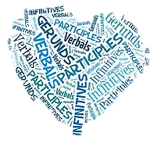
Verbals
Infinitives
Gerunds
Participles
Notes:
Verbs are very malleable; they can take a variety of forms. You may have noticed!
Verbals are derived from verbs, but they function in different ways. They include: [slide]

Slide 70
Verbals: Infinitives
Infinitives
  familiar “to + verb” structure
  can be used as nouns, adjectives & adverbs
  efficient – avoids subject repetition
  allow embedding of one sentence into another (to clarify meaning)
  easy to spot except when “bare”
Notes:
The Infinitive form is . . .
characterized by the familiar “to + verb” structure (to go, to call, to eat, to walk) and
can be used as a noun, adjective, and adverb
Infinitives are used for efficiency
they allow you to avoid repeating the subject in a sentence and
they allow you to embed one sentence into another, which helps clarify meaning
structure itself (“to + verb”) is a useful clue for recognizing an infinitive
sometimes, however, the word to is omitted and it becomes a “bare infinitive,” making it tricky to spot (examples below).
EX: Help Ruby get the coffee ready. Help Heather prepare the manuscript.

Slide 71
Verbals: Gerunds
Gerunds
  present participle (-ing verb form)
  take the place of a noun or pronoun
  can be preceded by the and followed by of (which may be present or assumed)
The handling of wild animals is for experts.
Cleaning is not my favorite activity.
The only thing he doesn’t like is cooking.
Notes:
Gerunds use the form of the present participle (the –ing form of a verb) to take the place of a noun or a pronoun in a sentence. You can tell the difference between present participles and gerunds because gerunds can be preceded by the and followed by of (which are sometimes present in the sentence and sometimes assumed).

Slide 72
Verbals: Participles
Participles
  present participle (verb stem + -ing) used to form the progressive tenses
  past participle (verb stem + -d or –ed) used to form the perfect tenses
    irregular verbs require a spelling change (e.g. buy → bought)
    some have both regular and irregular forms (e.g. burned/burnt)
Notes:
As we’ve already covered . . . Participles can occur in either the present or the past tense. Both tenses are formed using a verb stem.
The present participle is formed by adding –ing to the verb stem and is used to form the progressive tenses.
The past participle is used to form the perfect tenses.
For regular verbs, it is formed by adding –d or –ed to the verb stem.
For irregular verbs, it is formed with a spelling change (buy → bought).
Some verbs have both regular and irregular forms

Slide 73
Developmental Notes: Verbs
You have a handout containing developmental notes for each grammatical form we address.
Please review the appropriate section as needed during the following Application Exercises.
Notes:
[Leave this slide up while preparing Application Exercises.]

Slide 74
Application Exercises
3A: Verb Description
3B: Verb Conjugation (optional)
3C: Verb Analysis
Notes:
[Review activity directions. Allow time for completion. Provide and discuss answers.]

Slide 77
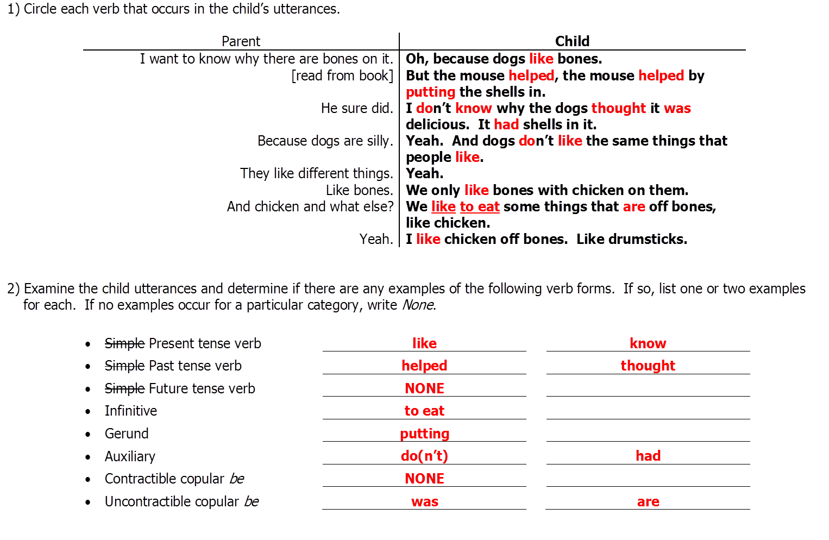

Slide 78
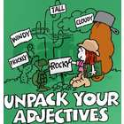
What Is an Adjective?
An important, open-class of words that provides info about nouns and pronouns
Generally referred to as “modifiers”
Important for narrowing down the qualities and properties of the words to which they refer
Two categories: Descriptive and Limiting
Notes:
Adjectives are an important class of words that serve as the descriptors in a language. They provide information about nouns and pronouns and may generally be referred to as modifiers, and more specifically as adjectival modifiers (as opposed to adverbial modifiers, which are coming up).
Like nouns, adjectives are an open-class of words – they come and go – some are enduring (delightful, exhausted), some vary in popularity (tubular, rad, groovy), new ones are created (online, brick-n-mortar), and common ones attain new meanings (heavy, bad, sweet).
As modifiers, adjectives are important for narrowing down the qualities and properties of the nouns and pronouns to which they refer.
They are the third largest group of words, following nouns and verbs, and are generally grouped in two categories: descriptive and limiting.

Slide 79
2 Types of Descriptive Adjectives
Attributive Predicate
9 Types of Limiting Adjectives
Proper
Possessive
Demonstrative
Cardinal
Ordinal
Indefinite
Interrogative
Nouns Used As…
Definite & Indefinite Articles
Notes:
There are . . . [read slide]. We will get to these two groups in a few minutes. First, let’s cover the basics . . .

Slide 80
Simple and Compound Adjectives
Simple adjectives: consist of a single word, e.g. tacky, experimental, shrill, delicious
Compound adjectives: consist of two words; formed three ways:
  Closed: combine two words into one word, e.g. pickup truck, ballpoint pen, hardcover book
  Open: two closely related words used together, e.g. child development center, Supreme Court ruling, high school teacher
  Hyphenated: hyphenating two words, e.g. parent-child interaction, low-income households
Notes:
Simple or Compound, like with nouns, is about the number of words making up the adjective. Oddly, the book doesn’t use the terms Closed, Open, and Hyphenated, even though it used the same basic definitions. So instead of underlining, I used a strikethrough to indicate that. Make of it what you will. I don’t think it’s a big deal what you call them as long as you can recognize the three kinds of compound adjective.

Slide 81
Three Adjective Forms
Positive (gradable) | Comparative (compares two) | Superlative (compares three+)
sleepy | sleepier | sleepiest
serious | more serious | most serious
studious | less studious | least studious
good | better | best
bad | worse | worst
❶
❷
Notes:
The positive (basic) form of adjectives can be inflected to create the comparative and superlative forms. Adjectives that can be modified to compare two or more entities along a continuum (smart, smarter, smartest) are referred to as gradable.
The comparative degree reflects a comparison of two nouns or pronouns and is typically formed by adding –er to the positive form. When an adjective cannot be modified with –er, the comparative form is made by adding either more or less before the positive form.
The superlative degree reflects a comparison of three or more nouns/pronouns and is typically formed by adding –est to the positive form. When an adjective cannot be modified with –est, the superlative form is made by adding either most or least before the positive form.
Some familiar exceptions to these rules are good, better, best and bad, worse, worst.
Some adjectives are nongradable (perfect, square, plastic) and cannot be modified into comparative and superlative forms, because they describe “all” or “none” – so to speak.
Something either is or isn’t perfect or square or plastic. It can’t be more perfect or less square than another object. It can’t be the most plastic item in a group.
To me, this is a little like with proper nouns earlier . . . if it’s a proper noun, then it’s unique and there can’t be more than one; therefore proper nouns can’t be plural.
Remember Red Lobster?
EX: The block is more square than the ball.
It might be fun to argue, but we’ll move on.

Slide 82
Descriptive Adjectives
Attributive adjectives most often precede nouns, e.g. The tall girl is in my class.
Predicate adjectives . . .
    can follow a copula e.g. The girl in my class is tall.
    and can follow intransitive verbs e.g. She seems sad.
  . . . to modify nouns/pronouns serving as subjects
  AKA complements – specifically subject complements – or as nominal predicates
Notes:
Descriptive adjectives describe a quality of the noun/pronoun they modify and come in two types: attributive and predicate.
Attributive adjectives most often precede nouns (The tall girl is in my class.).
Predicate adjectives
can follow a copula (The girl in my class is tall.) and
can follow intransitive verbs (She seems sad.)
. . . to modify nouns/pronouns serving as subjects.
also referred to as complements – specifically subject complements – or as nominal predicates.

Slide 83
Common Adjectival Suffixes
al: actual, adjectival, categorical
ous: conscious, glorious, serious
y: easy, nasty, pretty, savory
ful: beautiful, plentiful, wonderful
ish: foolish, pinkish, selfish, feverish
less: blameless, bottomless, careless
ive: expensive, native, plaintive
ial: presidential, inferential, influential
ent: excellent, intelligent, belligerent
ic: caloric, endemic, syntactic, optic
like: childlike, catlike, grapefruitlike
en: frozen, brazen, waxen, oaken
Notes:
Some descriptive adjectives occur in a simple, unmodified form (long, tall, green), but a large number of them can be readily recognized . . .
by the presence of an adjectival suffix, and
by considering their meaning and what they are modifying.
Although most descriptive adjectives are easily recognized due to their frequent position in front of a noun, they can also directly follow the noun they modify as in . . .
She only drinks her soda cold.
She keeps her office organized.
In some cases, they occur without a noun, typically following the article the, as in . . .
Feed the hungry.
Pay attention to the obvious.

Slide 84
Limiting Adjectives
Modify nouns by focusing on how much, how many, what kind, whose, etc.
Can include other parts of speech that take on an adjectival role
AKA determiners
Nine types: proper, possessive, cardinal, ordinal, demonstrative, indefinite, interrogative, nouns uses as adjectives, and definite & indefinite articles
Notes:
Limiting adjectives . . .
Modify nouns by focusing on how much, how many, what kind, whose, etc.
Can include other parts of speech (nouns/pronouns) that take on an adjectival role, which can make syntactic analysis of adjective use difficult for SLPs.
AKA determiners by many scholars.
Nine types: proper, possessive, cardinal, ordinal, demonstrative, indefinite, interrogative, nouns uses as adjectives, and definite & indefinite articles
Mark this slide for later reference . . . when we talk about Determiners.

Slide 85
Common vs Proper Adjectives
blue
tall
long
heavy
ugly
sharp
beautiful
Shakespearean
Calvin Klein
Dell
Japanese
bunsen
french
manila
Notes:
Common adjectives are descriptive and general in their meaning. [left list]
Proper adjectives are limiting and refer to distinct entities. [right list – first three]
They are often – but not always – modified from their proper noun counterparts by the addition of the suffix -ese (Japan + -ese = Japanese).
Like proper nouns, proper adjectives are typically capitalized, though there are a few exceptions [right list – last three] which have taken on common meanings and are often lowercase.

Slide 86
Possessive Adjectives
The man’s dog escaped over the weekend.
(possessive common noun used as adjective)
Please don’t eat all of Janet’s cookies.
(possessive proper noun used as adjective)
His hair is a wreck!
(possessive pronoun used as adjective)
Notes:
When common and proper nouns and pronouns are used to signify possession, they become adjectival in function and are considered possessive adjectives. Here are some examples.
Again, when possessive adjectives precede a noun, they are commonly referred to as determiners.

Slide 87
Demonstrative Adjectives
Please help her hang this wallpaper.
That one is the best.
These shoes are too tight.
(demonstrative adjectives)
vs
(demonstrative pronouns)
Please help her hang this.
That is the best.
These are too tight.
Notes:
Demonstratives (pronouns – this, that, these, those) may also serve an adjectival role.
Think about how the top three sentences differ from the bottom three. [slide]
Demonstrative adjectives are also a type of determiner.

Slide 88
Cardinal Adjectives
Numbers used to denote a specific attribute of a noun/pronoun
“Counting numbers,” such as one, two, five, fifty-five, that modify by stating how many
A type of determiner referred to as a “quantifier”
One type of “numeric” adjective
EX: It was only thirty-four cents!
Notes:
[read slide]

Slide 89
Ordinal Adjectives
Another type of “numeric” adjective
Numbers that denote the order of a noun or pronoun in a series, such as first, second, fifth, fifty-fifth
Also a type of determiner referred to as a “quantifier”
EX: Jason came in fourth place. This is the millionth time I’ve reminded you.
Notes:
[read slide]

Slide 90
Nouns Used as Adjectives
Usually identical in form as their noun counterparts
Not as easily recognizable as those with common adjectival suffixes
EX: my computer class, that kitchen gadget, the porch light
EX: It’s in my top desk drawer. Could you hand me my coffee cup?
Notes:
Many nouns can be used as adjectives. [read slide]

Slide 91
Definite & Indefinite Articles
Articles include the, a, and an
  Definite: the
  Indefinite: a, an
Both can serve an adjectival role, but are considered articles, or sometimes determiners, in syntactic analysis
EX: The boy is on his way. It is not an issue. I need a paintbrush for this.
Notes:
[read slide]

Slide 92
Indefinite Adjectives
Nancy has several dogs.
Please share both pieces of information.
(indefinite adjectives)
vs
(indefinite pronouns)
Nancy has several.
Please share both.
Notes:
In addition to indefinite articles, indefinites can also be a type of limiting adjective. Indefinite adjectives include all those words from the indefinite pronouns slide (that I asked you to mark earlier). These words can serve as either a pronoun or an adjective, based on their function in a sentence. Again, note the difference between the two sets of sentences.
When one of these words modifies a noun or pronoun, it is an indefinite adjective.
When one of these words takes the place of a noun, it is an indefinite pronoun.

Slide 93
Interrogative Adjectives
Whose pencil is this?
Which hat did you say you wanted?
(interrogative adjectives)
vs
(interrogative pronouns)
Whose is this?
Which did you say you wanted?
Notes:
Whose, which, and what are interrogatives that can serve an adjectival role when they modify nouns. Again, note the difference between the use of the interrogative adjective and the interrogative pronoun.

Slide 94
General Sequence for Adjectives
Limiting Adjective/Determiner the
+ Opinion/Quality dirty
+ Size + Shape big, bulky
+ Condition/Age old
+ Color + Pattern green, plaid
+ Material + Origin woolen, Naval
+ Noun Used as an Adjective pea COAT
Notes:
Most people order their adjectives appropriately without giving it much thought, but there is a generally accepted sequence for stringing adjectives together.

Slide 95
Developmental Notes: Adjectives
You have a handout containing developmental notes for each grammatical form we address.
Please review the appropriate section as needed during the following Application Exercises.
Notes:
[Leave this slide up while preparing Application Exercises.]

Slide 96
Application Exercises
4: Adjective Description
Notes:
[Review activity directions. Allow time for completion. Provide and discuss answers.]

Slide 98
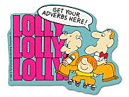
What Is an Adverb?
Also generally referred to as a “modifier”
More flexible than adjectives, but linked to a “head word”
Words that provide info . . . about verbs, adjectives, and other adverbs
. . . regarding manner, place, time, degree, number, reason, affirmation, and negation
Notes:
Adverbs, like adjectives, serve to modify elements in a sentence and so are also considered modifiers. Whereas adjectives modify nouns and pronouns, adverbs modify verbs, adjectives, and other adverbs.
Adverbs are more flexible than adjectives in terms of placement within a sentence since they can occur anywhere. Regardless of position, however, adverbs are always linked most significantly to a single word in the sentence, referred to as the head word.
A head word is the word (usually a verb) being modified. Generally, adverbs are positioned as close to the head word as possible, although, of course, this is not always the case.
For example . . . what is the head word in these 3 sentences? Completed
She effortlessly completed the exercise.
Effortlessly, she completed the exercise.
She completed the exercise effortlessly.
Adverbs are one of the more difficult word classes to describe. Many words are classified as adverbs because they do not seem to fit neatly into any other category.
A number of them can be easily identified by the appearance of the suffix –ly. Others, like fast and well, are more difficult to spot.
Adverbs provide information about manner, place, time, degree, number, and reason. They are also often used to affirm and to negate.

Slide 99
Simple and Compound Adverbs
Simple:
  single words often formed by adding –ly to a word stem
  also formed by adding –s, –wise, or -ward to a noun (e.g. afternoons, clockwise, skyward)
Compound:
  compound words joined by combining two words, hyphenating two words, or by hyphenating a prefix and a word; relatively rare
  commonly occur as groups of words (e.g. over there, very early, too much); “adverb phrases”
Notes:
Simple adverbs are single words. They are often formed by adding the suffix –ly to a word stem (courteously, politically).
They can also be formed by adding –wise, -ward, or –s to a noun. As in . . .
Play continues clockwise. OR The report met the requirements wordwise, but it was lousy.
He looked skyward for an answer. OR We finally steered the boat shoreward.
I have class Tuesdays and Thursdays this semester. OR Mornings I’m busy, but afternoons I’m free.
You might think Tuesdays, Thursdays, mornings, and afternoons are plural nouns, but they are actually adverbs that tell when you have class and when you are busy or free.
Compound adverbs are compound words, joined either by combining two words or by hyphenating two words or by hyphenating a prefix and a word. These are relatively rare and include words, such as (counterclockwise, contra-lateral).
Some adverbs commonly occur as groups of words, such as over there, very early, and too much. One way of looking as such groups is that the first adverb is modifying the second one in the pair. These groupings may be more accurately referred to as adverb phrases, which we will get to later.

Slide 100
Three Adverb Forms
Positive (3 varieties) | Comparative (compares two) | Superlative (compares three+)
sleepily | less sleepily | least sleepily
carefully | more carefully | most carefully
early | earlier | earliest
pretty | n/a | n/a
badly/well | worse/better | worst/best
there so too very here
❶
❷
❸
Notes:
As with adjectives, adverbs can take three forms.
The Positive form is usually one of three varieties.
The adverb is made by adding a suffix to an adjectival form. [top two] (sleepy + -ly, careful + -ly)
easiest to recognize (easily, slowly, happily, completely)
Note: not all words ending in –ly are adverbs; silly and lovely are adjectives that happen to end in –ly
Comparative degree is formed by adding either more or less in front of the positive form of the adverb (more carefully, less sleepily)
Superlative degree is formed by adding either most or least in front of the positive form of the adverb (most carefully, least sleepily)
The adverb is the same as its adjectival counterpart. [next three] (early, late, pretty, north, west, left, right, forward, backward)
meaning that the same word can be used as both an adjective and an adverb
Early risers succeed. (adjective) Let’s get there early. (adverb)
Comparative degree takes the same form as the adjective would by adding –er to the positive form (earlier)
Superlative degree takes the same form as the adjective by adding –est to the positive form (earliest)
It turned out so pretty. (adjective) I feel pretty good about it. (adverb)
As always, there are exceptions (pretty) and irregular forms (badly, well).
The last variety of positive form is a set of words that just need to be recognized remembered as adverbs: so, too, there, here, very.
Let him play too. He drives so very slowly. Jake drove here and there.
Memory strategy: Story about Tres, Kaben, and Payton’s “so too very . . . “

Slide 101
8 Major Adverb Types
Manner: We carefully placed the mice back.
Place: Please put the boxes here by me.
Time: We went early so we could help.
Degree*: I was really tired after the race.
Number: Sally will first explain her answer.
Reason: Jim is in time-out because he hit.
Affirmation: Indeed, we have been waiting.
Negation: Tom has never been to Omaha.
Notes:
Adverbs provide 8 types of information: manner, place, time, degree, number, reason, affirmation, and negation. Here are some examples. [read slide]
In some cases, adverbs (particularly adverbs of degree) may be confused with adjectives. This confusion most often occurs when adverbs modify adjectives, as in Jennifer is really hungry. In such situations, one might make the common mistake of characterizing both really and hungry as adjectives, when, in fact, really is an adverb that is modifying the predicate adjective hungry.
Common degree adverbs, which can be confusing this way, include rather, really, so, somewhat, often, much, and terribly.

Slide 102
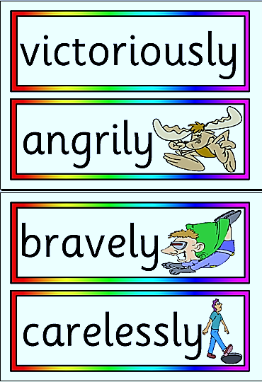
Manner Adverbs
Answer the questions How? and In what way? and indicate aspects of quality
Include many of the –ly adverbs, such as quickly, particularly, carefully
Also include . . . anyway, how, however, well, and somehow
Notes:
Adverbs of manner/Manner adverbs . . .
answer the question How? and In what way?
also indicate aspects of quality
include many of the –ly adverbs
also include anyway, how, however, somehow, well

Slide 103
Place Adverbs
Answer the question Where?
Include words like . . . about, anywhere, around, behind, here, nowhere, near, on, outside, there, upon, where, within, and without
Have a subclass referred to as direction adverbs that include above, back, below, forward, onward, and out
Notes:
Adverbs of place/Place adverbs . . .
answer the question Where?
includes words like [slide]
have a subclass referred to as adverbs of direction that include [slide]

Slide 104
Time Adverbs
Provide information related to duration and frequency of events
Answer the questions How long? When? and How often?
Include words like . . . after, again, already, always, before, immediately, instantly, lately, now, once, presently, rarely, today, weekly, and while
Notes:
Adverbs of time/Time adverbs . . .
provide information related to duration and frequency of events
answer the questions How long? When? and How often?
includes words like [slide]

Slide 105

Degree Adverbs
Answer the question How much?
Include words like . . . all, almost, barely, besides, equally, even, evenly, little, much*, more, most, nearly, only, quite, really*, so*, some, surely, too, and very
Notes:
Adverbs of degree/Degree adverbs . . .
answer the question How much?
include words like . . . [slide]

Slide 106
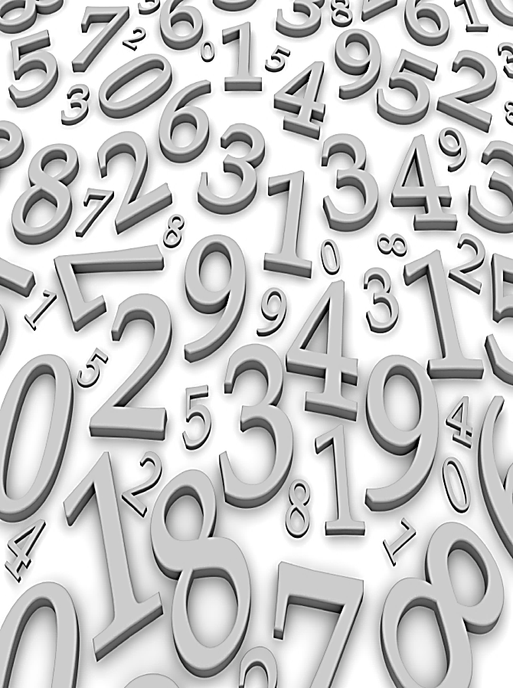
Number Adverbs
Provide information about the order of events
Include words like . . . first, second, third, seventy-fourth, and millionth
May also be formed by adding –ly to cardinal numbers, as in . . . secondly, thirdly
Notes:
Adverbs of number/Number adverbs . . .
provide information about the order of events
include words like . . . [slide]
may also be formed by adding –ly to cardinal numbers, as in secondly, thirdly

Slide 107
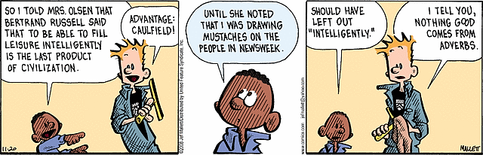
Reason Adverbs
Answer the questions Why? and What was the cause?
Include words like . . . because, hence, consequently, since, subsequently, therefore, and thus
Notes:
Adverbs of reason/Reason adverbs . . .
answer the questions Why? and What was the cause?
include words like . . . consequently, therefore, thus, because, and hence

Slide 108
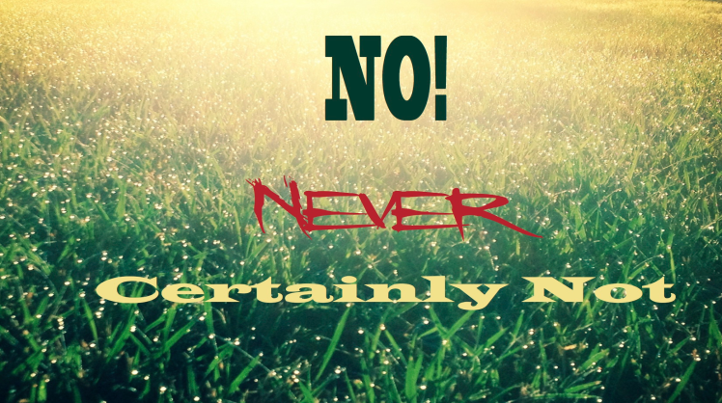
Affirmation Adverbs
Express agreement, approval, or assent
Include words like . . . absolutely, certainly, definitely, indeed, really, surely, and truly
Yes, yes also falls into this category!
no not never
Negation Adverbs
Notes:
Adverbs of affirmation/Affirmation adverbs . . .
express agreement, approval, or assent
include words like . . . absolutely, certainly, definitely, indeed, really, surely, and truly
Yes, yes also falls into this category!
Adverbs of negation/Negation adverbs . . . include no, not, and never.

Slide 109
Adverbial Conjuncts
accordingly
additionally
also
alternatively
besides
consequently
even so
for example
further
furthermore
hence
however
in addition
in contrast
in fact
indeed
likewise
moreover
nevertheless
notwithstanding
on the contrary
otherwise
rather
similarly
so that
still
that is
thereafter
therefore
thus
Notes:
Adverbs may also serve as conjunctions. Conjunctions (coming up) join two or more sentence elements.
Adverbs serving this role are known as conjunctive adverbs or adverbial conjuncts.
Conjunctive adverbs . . .
include words like . . . [slide]
are easy to spot because they are often preceded by a semicolon and followed by a comma.
Note: not all conjunctions are adverbs
Mark this slide for later . . . when we talk about Conjunctions. The same words apply.

Slide 110
Developmental Notes: Adverbs
You have a handout containing developmental notes for each grammatical form we address.
Please review the appropriate section as needed during the following Application Exercises.
Notes:
[Leave this slide up while preparing Application Exercises.]

Slide 111
Application Exercises
5A: Adverb Description
5B: Adverb or Conjunct
Notes:
[Review activity directions. Allow time for completion. Provide and discuss answers.]

Slide 113

What Is a Determiner?
“…determines the grammatical reality of the noun to which it is attached.” (Master, 1995)
Similar to limiting adjectives, but are more restricted in the modifications they make
Look like pronouns sometimes, but cannot exist outside a noun phrase
Include . . . possessives, articles, demonstratives, quantifiers, and wh-words
Notes:
Nouns in noun phrases are often preceded by at least one determiner, which serves to clarify aspects of the noun. Noun phrases can contain several determiners.
The role of the determiner is important since it “determines the grammatical reality of the noun to which it is attached.” (Master, 1995) For example, the word cat has limited meaning until we attach determiners to specify which cat (this cat, one cat, a cat, my cat).
Determiners are similar to limiting adjectives (9) in that they modify nouns; however, they are more restricted in the modifications they can make.
They can also look suspiciously like pronouns at times, (remember the comparison slides?) with an important exception: Determiners, by nature, cannot exist outside a noun phrase. Pronouns can.
The major categories of determiners are . . . (almost the same as limiting adjectives)
definite and indefinite articles,
possessives (both nouns, pronouns),
demonstratives,
quantifiers, and
wh-words.
It’s likely that you’ll get confused when you try to classify a word as determiner, adjective, or pronoun. Suffice it to say that your confusion is warranted. And to make it worse, there is often overlap between these three categories.
For example, the word his …
…in the sentence The coat is his… is a possessive pronoun.
…in the sentence His coat is on the hanger… his is both a possessive adjective AND a determiner.

Slide 114
Determiner Categories
Category | Examples
Articles | a, an, the
Possessives | dog’s, Dan’s, my, your, his, her, its, our, their (mine, yours, hers, ours, theirs)
Demonstratives | this, that, these, these
Quantifiers | all, any, both, every, first, each, either, few, less, neither, three, another, no, some, more, most, never
Wh- Words | what, which, whose, whatever, whichever
Notes:
The most commonly used determiners are the Articles a and the. The third is an, which occurs less frequently. The use of a and an are based on phonetic context. A before initial consonant words; AN before initial vowel (and vowel-sounding) words.
We already know these three little words are divided into two categories: definite (the) and indefinite (a, an) . . . and how they refer to specific vs nonspecific entities, respectively.
You can also use indefinite articles to indicate that information is new, then switch to the (definite article) after the information is no longer new. For example . . .
I have to tell you about a party I went to.
We’d been at the party about an hour, when this strange man . . .
The rest of these words work basically the same as their limiting adjective counterparts, (some adverbs), and can be confused with their pronoun version.
Possessives can be divided into two types: possessive nouns (common and proper) and possessive pronouns. Remember: When these words stand alone, then they are not determiners or adjectives.
Demonstratives, you’ll recall, include this, that, these, and those. Similar to possessives, when demonstratives stand alone, taking the place of nouns, they are not determiners or adjectives, but demonstrative pronouns.
Quantifiers include words that provide information about quantity. Again, many can also serve as, pronouns, adverbs, and adjectives. Remember that determiners always introduce and elaborate on a noun phrase. Ref: indefinite, cardinal, and ordinal adjectives . . . and degree and number adverbs.
Wh- Words as determiners modify a noun or pronoun, similar to interrogative adjectives. Contrast with interrogative pronouns.
So. . . basically, we need to be able to tell the difference between when these words are used as pronouns vs adjectives . . . and when they are adjectives, tell if they are also determiners.

Slide 115
Developmental Notes: Determiners
You have a handout containing developmental notes for each grammatical form we address.
Please review the appropriate section as needed during the following Application Exercises.
Notes:
[Leave this slide up while preparing Application Exercises.]

Slide 116
Application Exercises
6: Determiner Identification & Categorization
Notes:
[Review activity directions. Allow time for completion. Provide and discuss answers.]

Slide 118
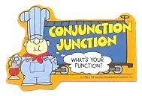
What Is a Conjunction?
A small, closed-class of words that serve to join words with words, phrases with phrases, and clauses with clauses
Most common: and, but, or (many others)
AKA adverbial conjuncts
Simple, Compound, & Phrasal
Coordinating, Correlative, & Subordinating
Notes:
Conjunctions comprise a relatively small, closed-class of words that serve to join words, phrases, and clauses. The most common ones are and, but, & or. Even though this set of words is relatively small, there are still many of them.
Conjunctions can also be groups of words, such as as soon as, rather than and in case.
A number of adverbs also serve as conjunctions when they connect two or more independent clauses. Then they are known as conjunctive adverbs or adverbial conjuncts.
We are familiar by now with Simple and Compound forms of words, regardless of the part of speech. Simple = one word; Compound = two nor more words combined into one word (e.g. nevertheless, whenever). Phrasal conjunctions occur as complete phrases and include . . . in other words, that is, even if, as such, and to this end.
There are three major types of conjunctions: coordinating, correlative, and subordinating.

Slide 119
Coordinating, Correlative, & Subordinating Conjunctions
Coordinating: For, And, Nor, But, Or, Yet, So; when analyzing narratives, include and then
Category | Examples
Additive | also, and, besides, likewise, moreover, then
Contrasting | but, however, nevertheless, notwithstanding, still, yet, or, otherwise
Separative | nor, or, otherwise
Final | consequently, for, hence, so, so that, therefore, thus
Notes:
Coordination means that the information on both sides of either a coordinating conjunction or an adverbial conjunct have equal weight and importance.
Coordinating conjunctions are . . . [slide]. Remember the mneumonic: FANBOYS. And then is also included in this group when analyzing narratives.
Opdycke (1965) classified them into four categories: [slide]

Slide 120
Coordinating, Correlative, & Subordinating Conjunctions
Correlative: both/and, either/or, neither/nor, whether/or, as/as, and if/then
Both Jason and Stuart will be at the match.
Either you take a bath or you are not going.
If you meet me at the bus, then we can go.
Whether we pass or fail, we’ve learned a lot.
Notes:
There are several sets of words than go together in pairs to form correlative conjunctions. In general, if the first word in a pair occurs in a sentence, then the second word in the pair must follow.

Slide 121
Coordinating, Correlative, & Subordinating Conjunctions
Subordinating: most frequently used; connect independent & dependent clauses
after
although
as
as well as
because
if
since
that
though
unless
until
when
where
whereas
wherever
whether
while
why
Notes:
Subordinating conjunctions are the most frequently used. They serve to join ideas together in a sentence. In contrast to coordinating conjunctions, subordinating conjunctions are used to connect one clause (main or independent) to another clause (subordinate or dependent) that has less weight and importance.
EX: Sentences.
Tell him [why you won’t be going.]
[Although Kim won’t be going,] she thinks we should still go.
Don’t touch it [while it’s cooking.]

Slide 122
Developmental Notes: Conjunctions
You have a handout containing developmental notes for each grammatical form we address.
Please review the appropriate section as needed during the following Application Exercises.
Notes:
[Leave this slide up while preparing Application Exercises.]

Slide 123
Application Exercises
7: Conjunction Identification
Notes:
[Review activity directions. Allow time for completion. Provide and discuss answers.]

Slide 125
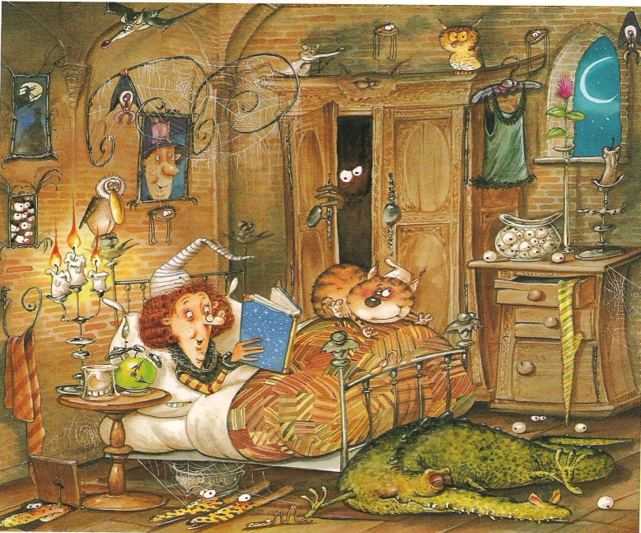
What Is a Preposition?
A small, finite class of words that serves to connect nouns & pronouns to other nouns, pronouns, and verbs; creates a relationship between its antecedent and its object
Can serve in both roles: adjectival & adverbial
7 Prepositional Functions
Simple, Compound, & Phrasal
Notes:
Prepositions comprise a relatively small, finite class of words that serve to connect nouns and pronouns to other nouns, pronouns, and verbs. They depict a precise relationship between two sentence units.
According to Opdycke, “a preposition is a term that shows a relationship between a word that follows it, called its object, and a word before it, called its antecedent, to which it pertains or relates.” The role of the preposition is to create a relationship between its antecedent and its object.
Prepositions may modify both nouns and verbs, therefore, they can function in both adjectival and adverbial roles. Consider . . .
Please put the milk [IN the refrigerator]. (adjectival: links noun phrase to noun phrase)
The man [WITH the shovel] helped us. (adjectival: links noun phrase to noun phrase)
as opposed to . . .
Stanley drove [OFF the road]. (adverbial: links verb phrase to noun phrase)
The ball fell [BETWEEN the cracks]. (adverbial: links verb phrase to noun phrase)
Typically, prepositions occur before nouns and noun phrases, like the first two above. Occasionally, and most commonly in informal speaking situations, they occur at the ends of sentences, such as . . .
What did you tell him FOR? (dangling modifer)
I don’t think she wrote that part IN. (dangling modifier)
This is ok for casual speaking, but I bet you were chastised in school for ending a sentence with a preposition, especially when writing.
It can sometimes be tricky identifying a preposition because verb particles look a lot like prepositions, as in I ran into my old teacher, in which into is a verb particle, not a preposition. It would be a common mistake and we’ll cover that distinction when we review prepositional verbs.
There are several prepositional functions. We’ll look at seven (7). There are also three types of prepositions: simple, compound, and phrasal.

Slide 126
Prepositional Function
Time: Tom will not arrive until Friday.
Place: Use the one that’s next to the candle.
Accompaniment: I never jog without my dog.
Destination/Purpose: Don’t leave for the party.
Means: We arrived by bus and then took a cab.
Possession: He is the author of the book
Relation: Nancy is the step-sister of my cousin.
Notes:
Prepositions provide information about [slide].
In my research, I also found “prepositions of direction” and “. . . of location.” Are destination and purpose really the same thing? I think we could label prepositional functions in several ways whether we choose to use these particular descriptors or not.

Slide 127
Common Simple Prepositions
about*
above*
across*
after*
against
along*
around*
before
behind
below*
between
beyond*
by*
down
like
near
off
on
out
over
past*
through*
throughout*
to
toward
under*
until
up*
with
within*
Notes:
There are three types of prepositions: simple, compound, and phrasal. As we have already learned, simple prepositions are single words. They represent a fairly large group of closed-class words. Here are some common examples. [slide]
Remember that one prepositional function is providing information about place. There is a relatively large group of simple prepositions that are referred to as prepositional adverbs. (marked some examples with an asterisk)
These prepositions provide additional information about verbs in a sentence. This characterization is subtle, but it’s important to recognize this fine distinction among the fairly large set of simple prepositions when put to use.
We walked across the bridge.
Let’s look within ourselves.

Slide 128
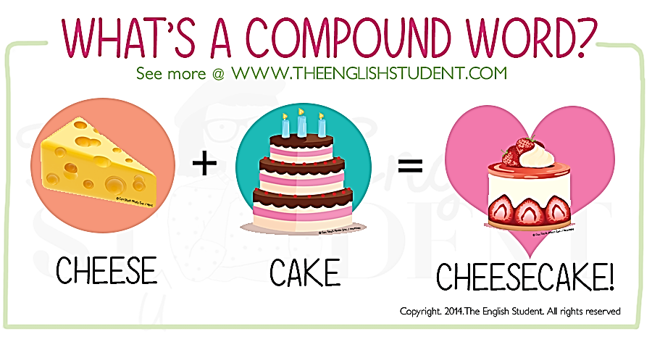
Compound Prepositions
Compound: two or more words combined
alongside
inside
nearby
outside
throughout
underneath
within
without
Notes:
Some prepositions are compound words, so they are known as compound prepositions. Here are some examples: [slide].
Jane will try to go without a reservation.
Meet us alongside the waterfront.
“Cheesecake” isn’t a compound preposition. I just thought we could pause for a nice thought.

Slide 129
Phrasal Prepositions
Phrasal: a group of two or more words
AKA complex prepositions
Not to be confused with prepositional verbs
Common form: “adverb + preposition”
according to
across from
along with
as for
as to
because of
for the sake of
in comparison with
in spite of
inside of
instead of
over to
prior to
up for
Notes:
There are a number of prepositions, called phrasal prepositions (AKA complex prepositions) that consist of a group of two or more words. Commonly the form of these phrasal prepositions is “adverb + preposition.” These should not be confused with prepositional verbs, coming up next.
Here are some examples. [slide]
Don’t go along with the plan if you don’t like it.
I’ll have that instead of this.

Slide 130
Prepositional Verbs
Prepositions Verb Particles that occur in tandem with a verb; idiomatic phrases
Form: “verb + preposition”
AKA phrasal verbs or two-part verbs
allow for
pick on
run into
attend to
look at
stand for
believe in
look for
stand up
drop off
object to
wish for
Notes:
There are a number of prepositions that can occur in tandem with a verb. These idiomatic (means: informal, native, colloquial) phrases are called prepositional verbs (AKA phrasal verbs or two-part verbs), and are formed by combining a verb with a preposition. In such cases, the preposition is not actually considered a preposition, but rather is referred to as a particle or, more specifically, a verb particle.
Some common prepositional verbs are . . . [slide].
Strictly speaking, particles are not prepositions at all; they are part of the verb. (They just look like prepositions to make your job tougher!)

Slide 131
Particle vs Preposition
He ran into a snag.
Jared waited on a customer.
(prepositional verbs)
vs
(prepositional phrases)
He ran into the burning building.
Jared waited on the yellow line.
Notes:
To identify prepositions, you must consider what the word is modifying. Consider the difference in meaning between the verbs in these sentences.
The first two contain prepositional verbs (ran into, waited on) with a direct object following it (snag, customer).
The second pair take the form of “verb + prepositional phrase” (ran + into the burning building, etc.)
Note that in the first sentence ran into is used in a figurative sense to mean “encountered a problem,” but in the other sentence it means he literally went inside.
Verb particles often appear immediately after the verb, but they also can be separated from it as well, and still retain their meaning.
Sara handed off the bill to her friend. Sara handed the bill off to her friend.
I’d like to check out these books. I’d like to check these books out.

Slide 132
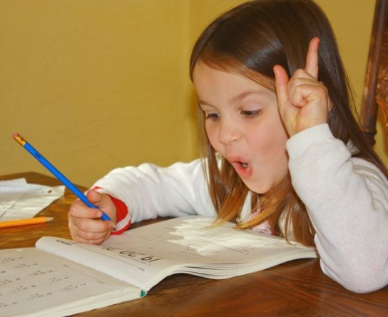
“This is the kind of grade up with which my dad won’t put!”
Notes:
Sometimes it is awkward to separate a particle from its verb.
The distinction between prepositional verbs and prepositions is an important one for SLPs, both when analyzing and when remediating language. If terms are confused in analysis, assessment results may become unreliable (tainted). If an intervention target is prepositions, be careful not to use prepositional verbs in the therapy context, which might be confusing for the student.

Slide 133
Developmental Notes: Prepositions
You have a handout containing developmental notes for each grammatical form we address.
Please review the appropriate section as needed during the following Application Exercises.
Notes:
[Leave this slide up while preparing Application Exercises.]

Slide 134
Application Exercises
8A: Prepositional Verbs
8B: Prepositional Phrases
Notes:
[Review activity directions. Allow time for completion. Provide and discuss answers.]

Slide 137
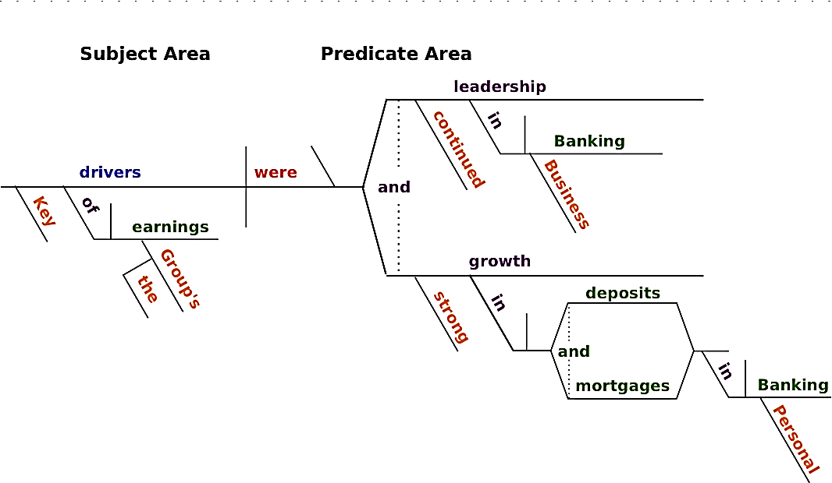
Remember These?
Notes:
So . . . those were syntactic forms or “parts of speech,” the detached tools we use in association or relation with other words. Now on to syntactic function or the “parts of sentences,” the unit of expression.
Remember these? [Refer them to next slide also]
One way of thinking about sentence structure is by viewing a sentence as consisting of several slots . . . that are filled by nouns, verbs, adjectives, adverbs, etc. The relationship between these slots is based on the different roles (functions) that words take . . . more than it is based on their part of speech (form).
Using words in different ways is part of what makes language generative and flexible . . . and is what children work toward as they learn to be mature language users.

Slide 138
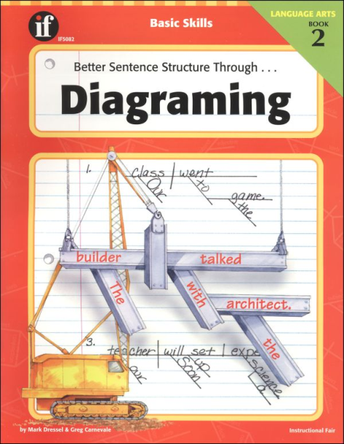
What Is Sentence Structure?
A sentence consists of several slots
Relationship between slots is based more on the different roles (functions) that words take than on their part of speech (form)
Characterized by two systems:
  Subject + Predicate
  Subject + Verb + Object
    Subject + Verb + Adverb
    Subject + Verb + Complement
Notes:
Sentences are typically characterized using one of two systems. The first, and simplest, identifies two basic sentence slots: a Subject area and a Predicate area. The subject occurs first in the sentence and reflects the action/state of the verb; the predicate is everything else, including the verb.
The subject slot is dominated by nouns and pronouns, as well as determiners providing further details about them. But the predicate is defined as “the grammatical unit made up of the verb plus other constituents following it,” which makes it less straightforward.
Many scholars use a different system for characterizing sentences, which identifies three basic sentence slots: Subject + Verb + Object. The verb and object are both elements of the predicate. This sentence structure is very common.
However, we know that not all sentences contain these three elements, which means. . . one of the three basic elements in this structure system is not obligatory. Sometimes, instead of an Object, an adverb follows the Subject + Verb (S+V+A), or a subject complement follows the S+V (S+V+C). We’ll get to that, but first let’s further define these three basic slots (S+V+O).
Regardless of how you label the sentence elements, the slots are rarely filled by single words. Usually they are composed of a series of phrases or clauses, so we’re going to run through this section quickly and get to that.

Slide 139
The Subject
Usually appears at the beginning of a sentence, before the verb (or predicate)
Defines who/what is the instigator of the action/state reflected by the verb
Can be simple, complete, or compound
Typically a noun, a pronoun, a noun phrase, or a clause; Occasionally an adjective, an infinitive, or a gerund
Sometimes unstated or “you-understood”
Notes:
In English, the subject usually appears at the beginning of a sentence before the verb (or predicate). It defines who or what is the instigator of the action or state reflected by the verb. Of course, sometimes the subject is an abstract entity that cannot instigate action (Syntax is quite interesting!). In such cases, consider the subject as depicting who or what the rest of the sentence is providing additional information about.
Subjects can be simple, complete, or compound.
Simple: typically nouns and pronouns
Complete: simple subjects plus their modifiers
Compound: subjects (simple or complete) conjoined by a conjunction
Regardless of which of these three types it is, the subject of a sentence is typically a noun, a pronoun, a noun phrase, or a clause. We are most familiar with nouns and pronouns serving as the subject.
Noun phrases, which we haven’t yet covered, are formed by adding modifiers (determiners, adjectives, adverbs) to nouns and pronouns (new pennies, wild and beautiful Alaska).
Clauses, which are also coming up, are more complex structures that can fill the subject slot. Easy to recognize if you remember that the subject tends to fill the slot directly preceding the verb.
What I’d like is a sunny day.
That they will attend the party is uncertain.
Occasionally, the subject slot is filled by an adjective, an infinitive, or a gerund.
The meek shall inherit the earth.
To err is human; to forgive, divine.
Seeing is believing.
Some subjects may be left unstated altogether (Get the door. Call me.) AKA “you-understood.”
Don’t worry about complexity. Just remember . . . the subject identifies the instigator of the action/state reflected by the verb.

Slide 140
The Object
Sentences containing transitive verbs must include an object as part of the predicate
Functions very differently than the subject, but form usually remains the same
Often fills the third slot in a sentence: S + (Trans) V + O [or S + (Int) V + Adv]
Two types: Direct and Indirect
  Direct: recipient of the action
  Indirect: recipient of the direct object
Notes:
Many, but not all, sentences include an object. Remember transitive and intransitive verbs? Sentences that contain intransitive verbs as the main verb often do not contain an object (The tree fell or The tree fell loudly) . . . and so better fit a Subject + (Intransitive) Verb structure or a Subject + (Int) Verb + Adverb structure.
Many other sentences contain transitive verbs and so include an object. In this case, the object is viewed as part of the predicate or a constituent of the verb, defining who or what receives the action reflected by the verb.
In terms of function, the object is very different from the subject. In terms of form, the subject and object are similar in that they both typically consist of a noun or pronoun.
Janie breeds dogs.
He paid her.
Often, the object fills the third slot in a sentence: Subject + (Transitive) Verb + Object. The object slot may be followed by additional modification that provides further information about the action.
Janie breeds dogs annually.
He paid her yesterday.
There are two types of objects: direct and indirect. Each takes a different role in a sentence.
Direct objects are what we’ve discussed so far – the recipient of the action. They often answer the question of What? or Who/Whom? with respect to the verb. (Jason wrote a letter. Jason wrote WHAT? Jason hit her. Jason hit WHOM?)
While direct objects are the firsthand recipients of a verb’s action, Indirect objects are the recipients of the direct object. They answer the questions “To whom or For whom was the action done? “. (Jason wrote a letter to Sue. Jason wrote a letter to WHOM?)
So while there are actually two objects in this sentence (letter, Sue), letter is the direct object (recipient of verb’s action) and Sue is the indirect object (recipient of the direct object or the beneficiary of the action).

Slide 141
Direct vs Indirect Objects
Clara gave the test to the child.
Clara gave the child the test.
Dean gave (to) her the papers
Dean gave (to) Teresa the papers.
Notes:
It can sometimes be difficult, though, to determine who or what is the recipient versus who or what is the beneficiary of the action/state.
For example . . . [read first two sentences]
Ask yourself the What? and Who/Whom? questions for each sentence. (Hint: Clara is the subject and gave is the verb in both sentences.) [Pause]
What did Clara give? the test. So that’s the direct object in both sentences.
To whom did Clara give the test? the child is the recipient of the direct object or the beneficiary of the action, so it is an indirect object (though it’s easier to spot in the first sentence).
This shows how confusing it can be to tell if an object is direct or indirect when both appear in a single sentence. So here’s a tip: The indirect object typically precedes the direct object. What are the indirect objects in the next two sentences? (her, Teresa) the papers serve as the direct object in both sentences.
Because it is often possible to transform a sentence so that the direct and indirect objects are reversed in order, a useful strategy for identifying the indirect object is by checking to see if the words to or for may logically be inserted before one of the objects.
Going back to the first example, second sentence, Clara gave the child the test. If you were unsure whether the child or the test was the indirect object, you could use this strategy. Add the word to in front of each object to see which could be used to help you reverse the order of the objects.
As you see, to can only be inserted in front of the child . Clara gave the child to the test doesn’t make sense. So the child must be the indirect object.

Slide 142
The Subject Complement
Provides further information about a subject AND follows copular(linking) verbs
Subject + (Cop) Verb + Subject Complement
Subject and Subject Complement refer to the same entity (copula is like an equal sign)
The famous linguist was Noam Chomsky.
It is I.
Ginger will be famous.
Notes:
Some sentences have subjects and verbs but no direct or indirect objects, and can appear complex, at least in terms of structural analysis. Each of the following sentences contain a subject, a verb, and additional information about the subject.
The famous linguist was Noam Chomsky.
It is I.
Ginger will be famous.
Notice that the additional information doesn’t include a direct or an indirect object. Instead, it includes a noun, a pronoun (called predicate nominatives) and an adjective (called a predicate adjective). These are collectively known as subject complements.
Subject complements provide further information about a subject AND follow copular/linking verbs.
Sentences that contain a predicate nominative or a predicate adjective following a copular verb have this sentence structure: Subject + (Copular) Verb + Subject Complement.
While a subject and an object (following a transitive verb) refer to different entities, a subject and a subject complement (following a copular verb) refer to the same entity. That is, the copular verb links the subject to the complement much like an equal sign.
Some scholars also describe object complements, but they are not as important to SLPs in terms of analysis, so the authors skipped it.

Slide 143
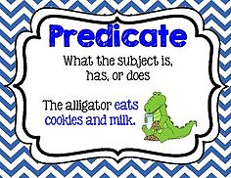
The Predicate
Everything in a sentence that is not the subject (the verb and its constituents, including subject complements)
Can be simple, complete, or compound
Tense and number must agree with the subject
Two main categories:
  Nominal Predicates
  Verbal Predicates
Notes:
The predicate is not synonymous with the verb in a sentence. It is actually everything in a sentence that is not the subject, that is, the verb and its constituents, including subject complements. This being the case, it’s not difficult to identify the predicate once you identify the subject.
I [always jog with my dog].
He [was hit with the baseball bat].
We [arrived by bus, but then took a cab to the hotel].
Cora [is the author of the book].
The predicate needs to agree with the subject in terms of tense and number.
One way to characterize the information comprising the predicate slot is by distinguishing simple, complete, and compound predicates.
Simple (AKA Essential): the main verb in a sentence or clause, providing the principle information contained in the entire predicate (The mist descended slowly.)
Complete: simple predicate plus all the modifiers that provide information about it (The mist descended slowly.)
Compound: consist of two or more simple predicates (The mist descended and evaporated.)
According to Palmer (1939), predicates, whether simple, complete, or compound, may be best classified into two main categories: nominal predicates and verbal predicates.

Slide 144
Nominal Predicates
Occur when the verb is copular or intransitive; AKA Subject Complement
Primarily include the verb followed by a noun, pronoun, prepositional phrase, adjective, or adverb
Categorized along 4 primary dimensions:
Prepositional noun
Prepositionless noun
Qualitative
Adverbial
Notes:
The terms nominal predicate and subject complement are more or less synonymous. They occur when the verb is copular or intransitive. Differentiation is subtle and really a matter of terminology. (Some scholars only use the term predicate to refer to information following transitive verbs, and use the term complement to refer to information following copular or intransitive verbs.)
When the predicate slot is filled by a nominal predicate/subject complement, it primarily includes the copular or intransitive verb followed by a noun, a pronoun, a prepositional phrase, an adjective, or an adverb.
There are various categories of nominal predicates, which can provide even more specific levels of analysis. A number of the more commonly seen types can be categorized along four primary dimensions:
prepositional noun predicates
prepositionless noun predicates
qualitative predicates
adverbial predicates
Refer to the handout: “Palmer’s (1939) Predicate Classification System”

Slide 145

Four Primary Dimensions
Prepositional noun predicates: prepositional phrase …follows a copular verb
Prepositionless noun predicates: noun or pronoun w/no prepositional phrase…
Qualitative predicates: qualitative info, like adjectives, adverbs…
Adverbial predicates: an adverb…
Notes:
Prepositional noun predicates: prepositional phrase …follows a copular verb.
The bananas are in the basket.
The diagnosis seems by the book.
Prepositionless noun predicates: noun or pronoun w/no prepositional phrase …follows a copular verb.
Those are not your black gloves.
Money isn’t everything.
Qualitative predicates: qualitative info, like adjectives, adverbs …follows a copular verb.
The fish is absolutely delicious.
She seems a little shy.
Adverbial predicates: an adverb …follows a copular verb.
It is not here.
The airplane appears far away.

Slide 146

Verbal Predicates
Occur when the verb is transitive
Categorized along 4 dimensions:
  Verb standing alone
  Prepositional object
  Prepositionless object
  Adverb
  Adverbial clause
Notes:
Verbal predicates occur when the verb in the sentence is transitive, rather than a copula or intransitive. These reflect the “action” of the subject, instead of mirroring it. Examples are endless: think, pull, know, give, hit, take.
Verbal predicates can be categorized along five dimensions:
Verb standing alone – is seen when a subject is followed by a verb that stands alone. The verbs may be modified for tense with auxiliaries.
I understand.
She does understand.
Prepositional object – is seen in cases where the predicate contains indirect objects or modifying information about manner, place, or time.
She called with his calling card. (manner)
She John called from Alaska. (place)
Luke will come on Wednesday. (time)
Prepositionless object – The verb is followed by a direct or an indirect object with no modification by prepositional information
The pan hit the table. (direct object)
You give her the money. (indirect and direct objects)
She called using his calling card. (manner)
John called Alaska. (place)
Luke will come Wednesday. (time)
Adverb – The verb is followed by an adverb, sometimes with an intervening direct object.
We teach here.
The clinician conducted the screening hastily.
Adverbial clause – Similar to above, but the adverbial information is presented in the form of a clause.
She addressed them before the microphone was on.
I will go when I’m ready.

Slide 147
Developmental Notes: Sentence Structure
You have a handout containing developmental notes for each grammatical function we address.
Please review the appropriate section.
We don’t need no stinking exercises!
Notes:
[Leave this slide up while preparing Application Exercises.]

Slide 148
Pause, Look Around, Smile
9A: Just Breathe
9B: Stretch It Out
Notes:
[Review activity directions. Allow time for completion. Provide and discuss answers.]

Slide 149
What Is a Phrase?
A syntactic structure that includes one main word and usually one or more closely associated words grouped around it
Cannot stand alone, but can be combined to form sentences
Building blocks are all those parts of speech “up”on which we just “boned” (Couldn’t resist!!)
word → phrase → clause → sentence
Notes:
As I said before that quick run-through . . . Regardless of how you label the sentence elements, the slots are rarely filled by single words. Usually they are filled by more elaborate structures that provide additional information:
My brother Jack ate the leftovers after the party.
Leslie’s new kitten jumped when the ball rolled past her.
A phrase is a syntactic structure that includes one main word and usually one or more closely associated words grouped around it. A phrase cannot stand alone because it does not have its own subject or predicate. Phrases can, however, serve in the role of subject or predicate within a sentence.
For example, that first sentence a minute ago is comprised of a series of phrases that fill the major sentence slots.
My brother Jack (in the subject slot is a [noun phrase])
ate (beginning the predicate slot is a [verb phrase])
the leftovers (part of the predicate slot is a [noun phrase])
after the party (finishing the predicate is a [prepositional phrase])
If we analyze these phrases, we notice that the building blocks are nouns, verbs, adjectives, adverbs, prepositions, and so on . . . all those parts of speech we just reviewed.
My brother Jack [noun phrase] == a determiner (possessive pronoun), a modifier (noun used as an adjective), and a noun (proper).
If we say the building blocks of phrases are the parts of speech, then we might also say that phrases (and clauses) are the building blocks of sentences.
Think of the structure of sentences, then as occurring in a hierarchy:
word → phrase → clause → sentence
This schema has the word as the basic building block of the phrase, the phrase as the basic building block of the clause, and the clause as the basic building block of the sentence.
Another way of looking at it is to say that a phrase includes one or more words, a clause includes one or more phrases, and a sentence includes one or more clauses.

Slide 150
Types of Phrases
Noun Phrases
Verb Phrases
Prepositional Phrases
Adjective Phrases
Adverb Phrases
Infinitive Phrases
Participle Phrases
Gerund Phrases
Notes:
The phrase typically has one central element, referred to as the head of the phrase. Heads of phrases can be nouns, verbs, adjectives, adverbs, and prepositions. A noun phrase has a noun (or pronoun) as its head; a verb phrase has a verb as its head, etc….
These head words are then appropriately modified by the different types of determiners, the different types of adjectives, the different types of quantifiers, right? … all those “specifics” within the different parts of speech that we’ve studied today.
That’s pretty much how the rest of this chapter breaks down: what parts of speech are used in each of these different types of phrases, the different patterns they form, and the different functions they serve.
We’ve learned a lot already about syntactic function just by studying form so specifically, so I’m not going to “subject” you to a specific, “parts-of-speech” breakdown for each of these types of phrases. I think you can do that yourself now.
Instead, in a handout for you to review on your own, I have put some charts and examples which I think you will understand without further explanation from me.
I would like to tell you one little thing about noun phrases before we look at the last three. (Can’t you tell my slide is too empty? Just not me.)
On occasion, a noun phrase can rename another noun phrase. When one noun phrase adds new information to another one without modifying it, the two noun phrases are said to be in apposition, and are called appositive phrases. For example, My consultant, Shelly Wier, is just as sick of grammar as you are. Or Casey, her daughter, is tired of it too.
[click]
There are also three types of phrases that do not have heads, and are considered distinct or special types of phrases: the infinitive, the participle, and the gerund.

Slide 151
Infinitive Phrases
A special type of phrase that uses the infinitive verb form to introduce itself
Consist of the infinitive (to + verb stem) plus any objects or modifiers
Include nonfinite verbs (do not reflect tense and number) but no subject, typically
Rare: subjects preceded by the word for
Bare: word to is not present in the phrase
Notes:
The infinitive phrase is a special type of phrase that uses the infinitive form of a verb to introduce the phrase. Some scholars view infinitives as a special type of clause, but they really do not fit neatly into the clause category because infinitives contain a verb (predicate) but not a subject. (Clauses are defined as containing their own subject and predicate.)
These authors choose not to consider infinitives to be clauses so as to be consistent with Loban’s (CU or communication unit, 1976) and Hunt’s (T-unit or minimal terminal unit, 1965) procedures for narrative language analysis, which are both based on a count of independent and dependent clauses.
However, be aware that various procedures for syntactic analysis (Retherford, 2000) consider the infinitive phrase to be a dependent clause that contributes to sentence complexity.
The bottom line is that you’ll need to know and follow the rules of the procedures you choose to use.
Infinitive phrases consist of the infinitive plus any objects or modifiers.
To feel successful in your career, you must be able to plan long-range goals.
Infinitive phrases include nonfinite verbs, in that the verb does not reflect tense and number. In contrast, finite verbs do (reflect tense and number). Infinitive phrases typically do not contain a subject; occasionally, the subject of the infinitive phrase is the same as the main clause to which it refers. [Refer them to next slide]
She wants him to go. (She is the subject of wants and him is the subject of go.)
She wants to go. (She is the subject of both want and go.)
In the rare instance that infinitive phrases do have subjects, the subjects are usually preceded by the word for.
Ginger is waiting for us to come.
The pediatrician is waiting for you to send the report.

Slide 152
Infinitive Phrases
She wants him to go.
She wants to go.
Ginger is waiting for us to come.
The pediatrician is waiting for you to send the report.
Help them [to] get the room ready.
Nicole wouldn’t dare [to] tell me.
Susan wants to loan the book rather than [to] give it to them.
Notes:
Although the presence of an infinitive form of a verb can be a useful clue in recognizing the presence of an infinitive phrase, sometimes the word to is not present. When this occurs, the phrase is referred to as a bare infinitive.
Help them [to] get the room ready.
Nicole wouldn’t dare [to] tell me.
The next example includes 2 infinitive phrases, the first includes a traditional to-infinitive, and the second is a bare infinitive.
Susan wants to loan the book rather than give it to them.
You can see that when sentences contain both traditional and bare infinitives, it may be difficult to accurately identify the phrasal structures making up the sentence.
Also, an infinitive phrase can be confused with a prepositional phrase (to them, last sentence above), but remember that in a prepositional phrase, to is followed by a noun or a pronoun, and in an infinitive phrase, to is followed by a verb.

Slide 153
Participle Phrases
Either the past or the present participle is the main word in the phrase; Serve both adjectival and adverbial functions
  Born with a severe hearing loss, Lisa is learning to sign. (past participle, adjectival function)
May also be introduced by subordinating conjunctions
  Before arriving at the lab, I stopped off for a sandwich. (subord. conj., adverbial function)
Notes:
Participle phrases are another special type of phrase. Remember . . .?
past participle: slept, walked, called, met
present participle: sleeping, walking, calling, meeting
In a participle phrase, either the past participle or the present participle of a verb is the main word in the phrase. They may serve adjectival and adverbial functions.
Born with a severe hearing loss, Lisa is learning to sign. (past participle, adjectival function
Arriving late, Jake sneaked in the back door. (present participle, adverbial function)
Participle phrases may also be introduced by subordinating conjunctions. The first word in each of the following phrases is a subordinating conjunction.
Before arriving at the lab, I stopped off for a sandwich.
When working in the clinic, you cannot wear open-toed shoes.
Like the infinitive phrase, participle phrases are sometimes viewed as a type of dependent clause, but, as before, the authors choose to consider them as a special type of phrase for the purposes of the narrative language analysis procedures they prefer.

Slide 154

Gerund Phrases
Includes a gerund plus any objects or modifiers
Always functions as a noun in a sentence
  We like playing dominoes.
  Hunting little mice is my cat’s passion.
  Cooking helps me relax.
Notes:
A third controversial structure is the gerund phrase. Again, there are some who view the gerund phrase as a special type of dependent clause, but the authors’ views are as previously mentioned.
A gerund phrase includes a gerund plus any objects or modifiers. A gerund phrase always functions as a noun in the sentence.
[read examples from slide]

Slide 155
Developmental Notes: Phrases
You have a handout containing developmental notes for each grammatical function we address.
Please review the appropriate section as needed during the following Application Exercises.
Notes:
[Leave this slide up while preparing Application Exercises.]

Slide 156
Application Exercises
10A: Noun Phrase Function
10B: Phrase Differentiation
Notes:
[Review activity directions. Allow time for completion. Provide and discuss answers.]

Slide 158
What Is a Clause?
A central syntactic structure consisting of a group of words that are unified by meaning
More complex than phrases because they have their own subject and predicate (similar to sentences)
Two types:
  independent or main clauses
  dependent or subordinate clauses
Notes:
Think, again, of the structure of sentences as occurring in a hierarchy: word → phrase → clause → sentence. An understanding of clause structure is critical for SLPs. Many tools used for analyzing language use clause structure as a key for documenting linguistic skill.
Previously mentioned, two frequently used procedures for assessment of narrative skills is analysis of Hunt’s T-unit (minimal terminal unit) and Loban’s CU (communication unit).
A T-unit consists of an independent clause and any attached dependent clauses.
A CU consists of an independent clause with its modifiers.
To be able to use these procedures effectively, SLPs must be able to differentiate dependent from independent clauses, as well as tell clauses from phrases. Since clause structure mirrors the complexity of the English language, clausal analysis can tell us much about the complexity of a student’s language skills, and can tell how much complexity he/she can handle before errors occur.
A clause is a central syntactic structure, which, like phrases, consists of a group of words that are unified by meaning. Clauses are more complex than phrases because they have their own subject and predicate.
In this way, they appear similar to sentences, since sentences too, must contain both a subject and a predicate. In fact, a sentence may be made up of a single clause, in which case the clause is the same thing as the sentence. For example, Tommy basted the turkey is a sentence consisting of a single clause, so sentence and clause are synonymous. Clauses that stand alone are referred to as independent or main clauses.
Other clauses, known as dependent or subordinate clauses, do not form a complete sentence on their own, so they must be combined with another clause to form a sentence. So . . . sentences always include an independent clause, but they can also include one or more dependent/subordinate clauses.
The key to understanding sentences that consist of more than one clause is recognizing that they include more than one verb (or predicate). For example, Ken, that boy I like, called me contains two verbs, which suggest the presence of two clauses.

Slide 159
Clause Elements
Refer to handout: “Key Clause Elements” and “Examples of Independent Clauses with Two, Three, and Four Slots”
Subject and verb are always obligatory
Object, complement, and adverbial slots are not always filled
A single clause may have four slots filled, but all five is not possible
Notes:
Clauses, like sentences, have 2 basic slots that must be filled: subject and predicate. Of course, clause elements can be more specifically classified, just like sentences. Please refer to the handout “Key Clause Elements.”
The subject and verb are always obligatory, but the object, complement, and adverbial slots are not always filled.
So a clause will always have at least two slots filled and may have as many as four slots filled at a time. Note, though, that is it not possible to have all five slots filled in a single clause.
Refer to the bottom of the same handout for “Examples of Independent Clauses with Two, Three, and Four Slots.”

Slide 160
Independent Clauses
Can stand alone like a sentence
Structure involves many different patterns
May be conjoined with a coordinating conjunction (FANBOYS, so then, and then)
  Nancy left Mike a message, and he returned her call.
  Nancy left Mike a message and then she left.
May be conjoined with an adverb conjunct
  We were tired; nevertheless, we plodded on.
Notes:
All sentences must have at least one independent (main) clause, which can stand alone. The next page in your handout shows some “Common Clause Patterns” of active and passive independent clauses.
When two or more independent clauses are conjoined with a coordinating conjunction (Remember FANBOYS+ so then, and then), the two clauses are referred to as coordinate clauses. In such cases, the clause that appears on one side of the coordinating conjunction carries equal weight with the clause that appears on the other side.
Nancy left Mike a message, and he returned her call.
Nancy left Mike a message and then she left.
Independent clauses can also be joined together with a conjunctive adverb/adverb conjunct.
We were tired; nevertheless, we plodded on.

Slide 161
Dependent Clauses
Contain a subject and predicate but cannot stand alone; begin with a subordinating conjunction or relative pronoun
Add information that can be deleted wo/ changing the meaning of main clause
May be conjoined w/ a coordinating conjunction (coordinate clause)
Four types: noun, adjective (relative), adverb, and comparative
Notes:
Like their independent clause counterparts, dependent clauses must also contain both a subject and a predicate, but they are different in that they cannot stand alone. They must be attached to an independent clause because they begin with either a subordinating conjunction or a relative pronoun.
The attachment of a subordinating conjunction or a relative pronoun to a clause causes it to be dependent. Dependent clauses add information, but they can be deleted without changing the meaning of the main clause to which they are attached.
I can go out because I don’t have any homework.
Chad brought me roses, which I thought was sweet.
Like independent clauses, two or more dependent clauses can also be conjoined with a coordinating conjunction. Again, the two clauses on either side of the conjunction are referred to as coordinate clauses because each clause carries equal weight.
Until you tell me what he did or until he confesses, I don’t want to see you.
We will review the more common structures that may be seen in the analysis of language transcripts. They include four types of dependent clauses: noun, adjective (relative), adverb, and comparative.

Slide 162
Noun Clauses
Always contain a subject and are always connected to an independent clause
AKA nominal or finite clauses
Function as nouns and can serve as subject, object, or complement
  What I believe is not important. (as Subject)
  This is who I am. (as Complement)
Often introduced by a relative pronoun
  I don’t believe [that] he told her. (as Object)
Notes:
Noun clauses are sometimes referred to as nominal clauses or finite clauses. Noun clauses always contain a subject and are always connected to an independent clause.
They function as nouns and thus may serve in the roles of subject, object, or complement.
What I believe is not important. (noun clause as subject)
This is who I am. (noun clause as complement)
Oftentimes, noun clauses are introduced by a relative pronoun, but be aware that the connective word that can be deleted making it difficult to identify the noun clause.
I don’t believe [that] he told her. (noun clause as object)

Slide 163
Adjective Clauses
Immediately follow the noun/pronoun that they modify in an independent clause
AKA relative clauses (introduced by a relative pronoun – present or omitted)
Sometimes introduced by a preposition
Can be characterized as…
  Restrictive: necessary for clarification
  Nonrestrictive: can be omitted without changing meaning of independent clause
Notes:
Adjective clauses immediately follow the noun or pronoun that they modify in an independent clause. They are typically introduced by relative pronouns, which is why they are often called relative clauses.
The boy who keeps calling is driving me crazy.
Here’s the book that I told you about.
On occasion, the relative pronoun may be omitted, making it tricky for you to identify the presence of an adjective clause.
Here’s the book I told you about.
Adjective clauses are not always introduced by a relative pronoun, though. In some instances, they are introduced by a preposition and then would NOT fall into the category of relative clause.
The tests with which we demonstrated are in the clinic.
Of course, in more casual situations, it’s appropriate for you to move the preposition to the end of the clause.
The tests which we demonstrated with are in the clinic.
Adjective clauses can be characterized as being either restrictive or nonrestrictive.
Restrictive clauses provide further information about the noun phrases they are modifying, and this information serves to narrow down the reference and is necessary for clarification. For example,
The boy who you called won’t speak to us. who you called modifies the noun phrase the boy and helps you understand which, of all the boys in the world, is the one who won’t speak to us.
Nonrestrictive clauses provide additional information about a particular referent, but this information is not necessary for recognizing the referent. In other words, nonrestrictive clauses can be omitted without changing the meaning of the independent clause.
Johnny called the lady, who invited him to dinner. (nonrestrictive adjective clause) as opposed to . . .
Johnny called the lady who had invited him to dinner. (restrictive adjective clause)

Slide 164
Adverb Clauses
Serve an adverbial function (time, place…) and begin with a subordinating conjunction
I need more coffee before the day begins.
Wherever you go, there you are!
She sang as though she were a bird.
They won’t go if it’s raining.
Because she seems to sad, we bought her this gift.
Notes:
Adverb clauses serve an adverbial function in that they provide information about time, place, manner, condition, and reason. In other words, adverb clauses answer questions about when, where, how, and why and begin with a subordinating conjunction.
Adverb clauses that answer when questions often begin with subordinating conjunctions like after, before, since, when, and while.
Adverb clauses that answer where questions often begin with subordinating conjunctions where or wherever.
Adverb clauses that answer how questions often begin with subordinating conjunction if.
Adverb clauses that answer why questions often begin with subordinating conjunctions because or so that.

Slide 165
Comparative Clauses
Serve to compare the information in the dependent clause with info presented in the independent clause
Always begin with the words than or as
John has more experience than Rick has.
They bought as many Beanie Babies as they could afford.
Notes:
Comparative clauses are a type of dependent (subordinate) clause that serves to compare the information in the dependent clause with information presented in the independent clause. Comparative clauses always begin with the words than or as.
John has more experience than Rick has.
They bought as many Beanie Babies as they could afford.

Slide 166
Developmental Notes: Clauses
You have a handout containing developmental notes for each grammatical function we address.
Please review the appropriate section as needed during the following Application Exercises.
Notes:
[Leave this slide up while preparing Application Exercises.]

Slide 167
Application Exercises
11A: Dependent Clause Identification
11B: Relative Clause Identification
11C: T-unit Identification
Notes:
[Review activity directions. Allow time for completion. Provide and discuss answers.]

Slide 170
The puppy went off on a walk by himself/ and he saw a little rabbit./ The rabbit ran fast into the woods/ and the puppy chased him until he got tired./ Then he sat down/ and he thought for a minute./ He changed his mind/ and he decided to eat something./ He looked around for stuff/ but he couldn’t find nothing./ Then he saw his best friend, who is Max./ And Max said he was having a party at his house./ They went to Max’s/ and all the friends were there.

Slide 171
What Is a Sentence?
A structure that consists of one or more independent clauses capable of presenting a complete thought in a manner which is grammatically acceptable. Classified…
Based on Clause Structure
Simple
Compound
Complex
Compound-Complex
Based on Overriding Function
Declarative
Imperative
Exclamatory
Interrogative
Notes:
Taking the perspective that syntactic structures can be viewed along a continuum, or hierarchy, sentences would be viewed as the most complex structural unit. Certainly we combine them into larger segments, such as paragraphs, narratives, stories, conversations and so on, but analysis of such large segments is less about syntax and more about discourse. That’s NOT what we’ll be reviewing here. The authors suggest Naremore, Densmore, and Harman’s (1995) text, Language Intervention with School-Aged Children: Conversation, Narrative, and Text, if you are interested in reviewing discourse analysis.
A sentence is defined as [slide]. Key elements in this definition include: Sentences must . .
1) include at least one independent clause, 2) present a complete thought, and 3) be grammatically acceptable.
With that in mind, would Come in be classified as a sentence? Yes.
It consists of an independent clause: a covert or you-understood subject, and the predicate come in.
It appears to present a complete thought.
It seems to be grammatically acceptable.
How about Oh my! or Really? Would these be classified as sentences? No, (although the capital letter at the beginning and the punctuation at the end make is look like one.) Neither structure contains one or more independent clauses. It could be argued that they present complete thoughts. One could even assert that they are grammatically acceptable (just not as sentences). It could not, however, be asserted that either contains a subject, and clearly neither contains a predicate. So they cannot be considered sentences. In fact, it is not really clear how to structurally define Oh my! or Really? although the function of each would be referred to as exclamatory.
[Refer to chart in handout “Classification of Sentences.”]
Sentences come in many shapes and sizes. Their complexity relates directly to the number of clauses each contains. The classification of sentence complexity as a function of clause structure results in four primary types of sentences: [slide].
Sentences may also be classified based on their overriding function. This system frequently occurs in discussions of children’s acquisition of four sentence types: [slide].

Slide 172
Developmental Notes: Types of Sentences
These notes are extensive and best saved for a time when our brains aren’t quite so exhausted.
You may want to review Acquisition of Brown’s (1973) 14 Grammatical Morphemes at a later date
Notes:
[Leave this slide up while preparing Application Exercises.]

Slide 173
Application Exercises
12: Sentence Classification
Notes:
[Review activity directions. Allow time for completion. Provide and discuss answers.]

Slide 175

Notes:
Well… I’m hoping you feel like this……

Slide 176

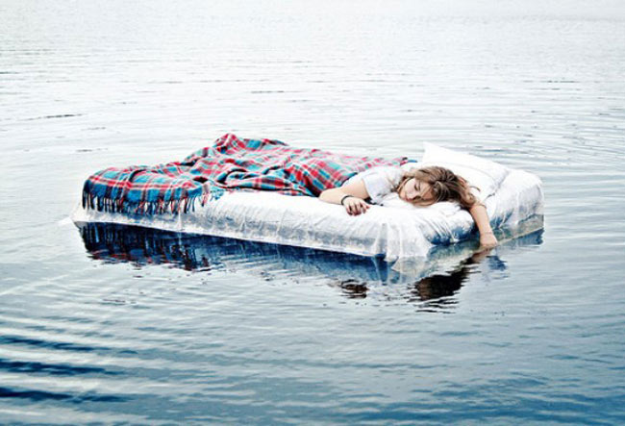
Notes:
……but I realize you probably feel like this.

Slide 177

Shelly Wier, MS, CCC-SLP
Consultant for School-Based Speech-Language Pathology Services
In association with the Arkansas Department of Education, Special Education Unit (ADE-SEU)
1401 West Capitol Avenue, Suite 425
Little Rock, AR 72201-2936
501.319.7333, ext. 123
Work cell: 501.993-4337
Email: shelly.wier@arkansas.gov
Website: www.arcommunicationboard.com
Notes:
Either way, I hope you’re leaving with a more practical understanding of syntax than that with which you arrived.
You know how to contact me, and please do, anytime.

